Slide 1


Trainers guide
The European Commission's support for the production of this publication does not constitute an endorsement of the contents, which reflect the views only of the authors, and the Commission cannot be held responsible for any use which may be made of the information contained therein.

Slide 2



You are welcomed!
We are excited to introduce you to the “Recognize and Act” board game,
an innovative, interactive tool designed specifically to address and combat occupational violence within the HORECA sector. This game integrates the principles of experiential learning and constructive methodology to facilitate an understanding of workplace violence, its causes, and effective prevention and management strategies.
The game emphasizes empathy and understanding from the perspective of all involved parties. This holistic approach fosters a comprehensive understanding of the complexity
of workplace violence, equipping you and the trainees with the necessary skills to recognize and respond effectively to such situations.

Slide 3






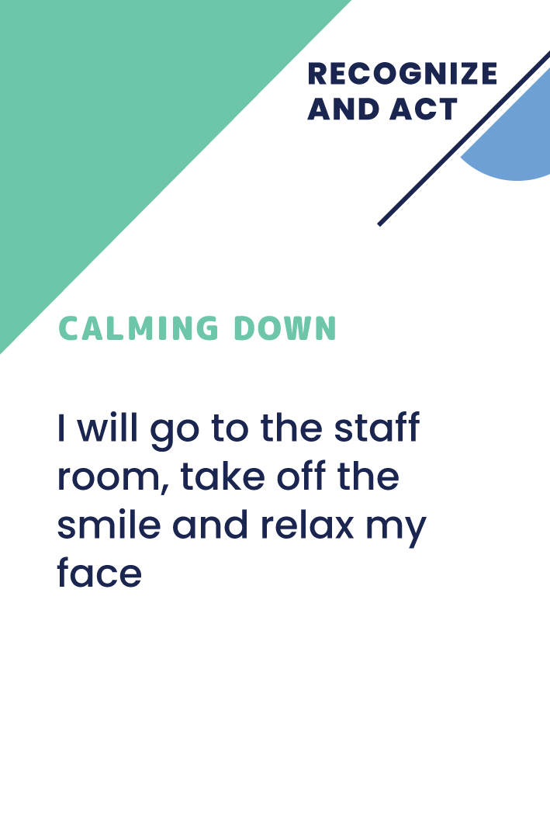

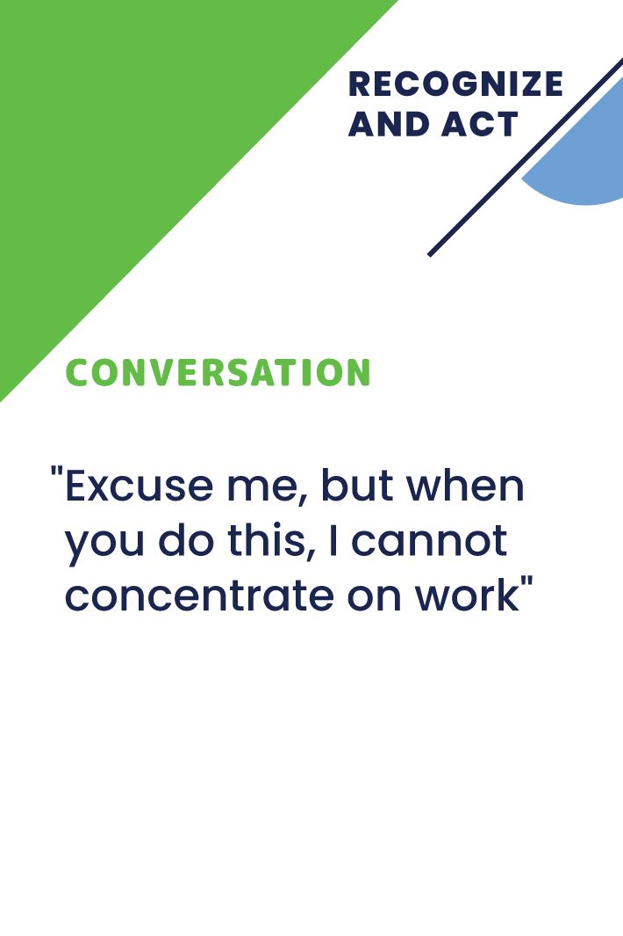
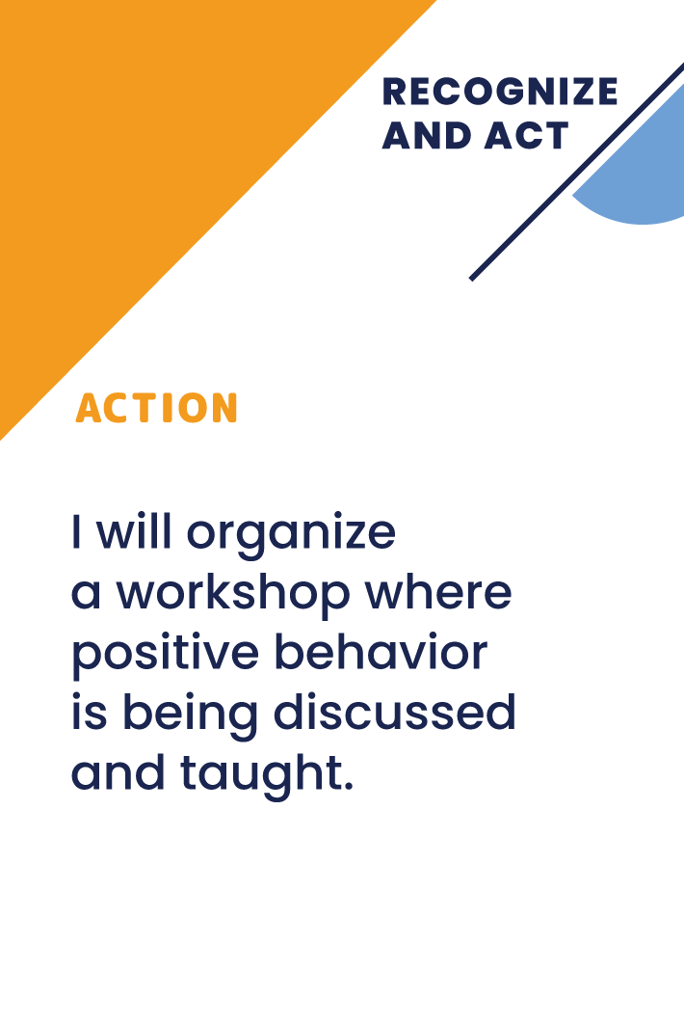
Game “Recognize and Act” consists of:
60 problem situation cards and 240 solution cards, divided into four solution groups:
60 Calming Down Strategies
60 Thinking Strategies
60 Conversation Strategies
60 Action Strategies
60 Stories

Slide 4










Game “Recognize and Act” consists of:
60 problem situation cards and 240 solution cards, divided into four solution groups:
60 Calming Down Strategies
60 Thinking Strategies
60 Conversation Strategies
60 Action Strategies
60 Stories

Slide 5










Game “Recognize and Act” consists of:
60 problem situation cards and 240 solution cards, divided into four solution groups:
60 Calming Down Strategies
60 Thinking Strategies
60 Conversation Strategies
60 Action Strategies
60 Stories

Slide 6










Game “Recognize and Act” consists of:
60 problem situation cards and 240 solution cards, divided into four solution groups:
60 Calming Down Strategies
60 Thinking Strategies
60 Conversation Strategies
60 Action Strategies
60 Stories

Slide 7










Game “Recognize and Act” consists of:
60 problem situation cards and 240 solution cards, divided into four solution groups:
60 Calming Down Strategies
60 Thinking Strategies
60 Conversation Strategies
60 Action Strategies
60 Stories

Slide 8










Game “Recognize and Act” consists of:
60 problem situation cards and 240 solution cards, divided into four solution groups:
60 Calming Down Strategies
60 Thinking Strategies
60 Conversation Strategies
60 Action Strategies
60 Stories

Slide 9
As trainers, you will guide the participants through various scenarios and engage them in discussions based on the situation and strategy cards.
This process will enable participants to actively learn and reflect on the different facets of workplace violence, thereby facilitating a shared understanding and encouraging open dialogue on this critical issue.

Slide 10
Your role as trainer
Playing this game in a digital format makes it accessible to a wider audience and adds an extra layer of convenience and flexibility, allowing participants to engage in learning irrespective of their location.
By using this game as a learning and assessment tool, we trust that you will inspire a culture change within the HORECA sector, encouraging
a more inclusive, safe, and respectful work environment.
Remember, your role is pivotal in this transformative journey,
and we look forward to the positive impact this game will create under your expert guidance.

Slide 11




1.
Getting prepared
for a training session
Notes:
DURAKS

Slide 12
Understanding the Game
Before you begin the training session, it's crucial that you familiarize yourself with the "Recognize and Act" game and its components.
Get familiar wit the content of the board game and understand the various problem situation cards and solution cards. Feel free to take out the cards which are not related to your training goals
Knowing how these cards work in conjunction with one another will help you guide participants through the game smoothly and effectively.

Slide 13
Understanding Your Audience
Get to know your audience. Research the HORECA sector they're part of, understanding the common challenges they face concerning occupational violence.
Understanding their perspective will enable you to relate the game scenarios to their real-life experiences, enhancing the learning process.
Before delivering the training using the "Recognize and Act" board game, there are several things you should know about your trainees to tailor your approach and facilitate the most effective learning experience:

Slide 14
Understanding Your Audience
Their Roles and Experience: Understand their positions within the HORECA sector and their professional experience. This will help you adapt the game scenarios
to make them more relevant.
Previous Training: Are they familiar with the concepts of workplace violence prevention and management? Have they participated in similar trainings before? This can help you gauge their existing knowledge and identify areas for further exploration.
Comfort Level with Games: Not everyone is equally comfortable with game-based learning. Knowing their familiarity and comfort with games can help you adjust how you introduce and manage the game.

Slide 15
Understanding Your Audience
Expectations: It's essential to know what they hope to gain from this training. Are there specific skills or knowledge they are hoping to acquire?
Learning Styles: Understanding their preferred learning styles will help you adapt your delivery method to enhance their engagement and understanding.
Cultural Background and Sensitivity: If you have a diverse group of trainees, being aware of their cultural backgrounds can ensure you deliver a respectful and inclusive training.

Slide 16
Understanding Your Audience
Real-life Experiences: If they feel comfortable sharing, their experiences or observations of occupational violence can provide valuable insights and make the training more relatable.
Organizational Policies: Knowledge of the trainees' organizational policies regarding occupational violence can help you connect the game scenarios to their real-life workplace situations.
Communication Styles: How do they prefer to communicate? Are they more comfortable with open discussions, or do they prefer more structured formats like Q&As or small group discussions?
Technology Proficiency: If you're using a digital version of the game or any other digital tools during the training, gauging their comfort level with technology is important.

Slide 17
2.
Reviewing the rules
Notes:
DURAKS

Slide 18
Reviewing the rules
Make sure to thoroughly review and understand the game rules. This way, you'll be ready to explain them clearly and answer any questions that the participants may have. Remember that the purpose of the game is to facilitate learning, so clarity and understanding of the game mechanics are essential.
You will find the basic rules of the game at the end of the presentation, but feel free to improvise, adjust and change them partly or fully.
You can develop your own content or ask to do for trainees – for example by creating your own problem situations or solutions

Slide 19
3.
Setting Up the Environment
Notes:
DURAKS

Slide 20
Setting Up the Environment
Whether the game will be played in-person or digitally,
ensure the environment is set up adequately for the training.
For in-person sessions, arrange the physical space to accommodate
the participants comfortably and allow easy movement.
For the hybrid and digital sessions, familiarize yourself
with the platform to ensure a smooth experience for all participants.

Slide 21
4.
Planning for Discussion and Feedback
Notes:
DURAKS

Slide 22
Planning for Discussion and Feedback
Plan time for discussions and feedback within the training schedule. These activities are essential components of the learning process.
Prepare some guiding questions or prompts to facilitate these discussions, focusing on the game's learning objectives.
Collecting feedback after the game can help evaluate its effectiveness, improve future iterations, and provide insights into participants' learning. You can collect the feedback not only about the content of the training, but for the game strategies as well

Slide 23
Planning for Discussion and Feedback - methods
Survey or Questionnaire: Design a post-training survey or questionnaire asking about participants' experiences with the game, the perceived value of the training, and the application of learned strategies in their work environment. This can be done through digital tools like Google Forms or SurveyMonkey or via a physical questionnaire.
Group Discussion: Arrange a debriefing session after the game. Encourage participants to share their experiences, key takeaways, and suggestions for improvement. You can structure this discussion using specific prompts or open-ended questions.

Slide 24
Planning for Discussion and Feedback - methods
Individual Interviews: Conduct one-on-one interviews with the participants. This can allow for more in-depth feedback and give participants the opportunity to share thoughts they might not feel comfortable sharing
in a group setting.
Self-Reflection: Ask participants to write a short reflection about their experiences playing the game and what they learned. This can help them internalize the knowledge gained and provide you with valuable insights into their learning process.

Slide 25
Planning for Discussion and Feedback
Online Feedback Platforms: If your training has a digital component, consider using online feedback platforms, where participants can leave their comments and rate the training.
Observation: As a trainer, take note of the dynamics during the game. Were participants engaged? Did they seem to understand the scenarios and strategies? This can provide insights into the effectiveness of the game.
Pre and Post Tests: Assess the participants' knowledge before and after the game to measure learning outcomes. This can be done through quizzes or short answer questions.

Slide 26
Planning for Discussion and Feedback
Feedback Box: If anonymity is preferred, a physical or digital feedback box where participants can drop their comments or suggestions can be helpful.
Peer Feedback: In small groups, have participants share feedback with each other about their game performance, teamwork, and learned strategies. They can then summarize the feedback to share with the larger group or trainer.

Slide 27
5.
Playing with managers
Notes:
DURAKS

Slide 28
Playing with the managers
Playing a board game like "Recognize and Act" in a training setting with HORECA managers can certainly present some unique challenges and issues.
Here are some points a trainer should bear in mind:
Hierarchy
Competitiveness
Different Learning Styles
Sensitive Topics
Time Constraints
Real-life Application:
Defensiveness:
Cultural Consideration
Confidentiality
Follow-up

Slide 29
For Managers
Hierarchy: Since you'll have a group of managers, there might be pre-existing dynamics based on their positions in the organization. It's important to create an environment where all participants feel equally comfortable and encouraged to participate.
Competitiveness: Managers often have a competitive spirit, which can be both a positive and a negative. While it can increase engagement, it might also cause some participants to focus more on 'winning' the game rather than learning from it.
Different Learning Styles: People have different ways of learning. Some may engage more with visual aids, while others might prefer discussions. It's important
to incorporate a variety of teaching strategies to cater to these differences.

Slide 30
For Managers
Sensitive Topics: Workplace violence is a sensitive topic, and some managers may have experienced or witnessed it. Ensuring the environment is respectful and safe for everyone is crucial.
Time Constraints: Managers often have busy schedules, so keeping the game and the training concise and engaging is important. It's also essential to start and end the session on time.
Real-life Application: Managers are more likely to be engaged if they can see how the skills learned can be applied in their roles. Ensure that game scenarios are realistic and relevant.

Slide 31
Planning for Discussion and Feedback
Defensiveness: If some managers have been part of environments where workplace violence occurred, they may feel defensive or uncomfortable. Assure them that the purpose of the game is not to place blame but to learn prevention and management strategies.
Cultural Considerations: If you have a diverse group of managers, ensure the content and discussions are respectful of all backgrounds.
Confidentiality: Ensure that any personal experiences shared during the training are treated with respect and confidentiality. This will encourage open and honest communication.
Follow-up: Some issues or questions may arise after the game has been played. Make sure to leave some time for discussion and provide resources for further learning and support.

Slide 32
6.
Training Structure
Notes:
DURAKS

Slide 33
Training Structure
Introduction: Brief explanation of the game and its objectives.
Gameplay: Playing the game in turns, discussing each situation and solution.
Theory session: Presentinf key theoretical concepts about occupational violence,
Debrief: Group discussion reflecting on the game and key learning outcomes.
Feedback: Collection of feedback for future improvements.

Slide 34
Training Structure
Introduction: Start with a warm-up activity to break the ice and build rapport among participants. Follow with a brief explanation of the game, its objectives, and relevance to their roles as HORECA managers. Introduce the topic of workplace violence, briefly discussing its forms and impacts.
Theory Session: Present key theoretical concepts about occupational violence, its types, signs, and potential effects on the workforce. This could involve
a presentation, video, or group reading and discussion of a relevant article
or case study.

Slide 35
Training Structure
Real-life Analysis: Discuss real-world examples or case studies of workplace violence
in the HORECA industry. This will provide context to the theory and make it more relatable. Ask participants to share (without revealing sensitive details) any experiences they've
had and how they handled those situations.
Game Explanation: Go through the game rules in detail. Make sure everyone understands the structure of the game, the purpose of the problem situation cards and solution cards, and the scoring system (if applicable).
Gameplay: Participants play the game in turns, discussing each situation and solution.
The trainer should facilitate the discussion, ensuring everyone is participating
and that the conversation remains respectful and productive.

Slide 36
Training Structure
Application to Real Life: After gameplay, guide a discussion about how the lessons from the game could be applied to real-life situations. Encourage participants to share insights about how they might handle similar scenarios in their own workplaces.
Debrief: Conduct a group discussion reflecting on the game, the solutions chosen, and key learning outcomes. This is an opportunity to reinforce the theoretical concepts covered in the training and their application in the game.
Wrap-Up: Recap the main takeaways from the training. Discuss next steps,
such as any follow-up activities, application of strategies in the workplace,
or additional resources for learning more about workplace violence.

Slide 37
Training Structure
Feedback: Collect feedback about the training session. This could be through a survey, group discussion, or one-on-one conversations. The feedback will provide valuable information for improving future training sessions.
Remember, it's important to ensure the training environment is safe, inclusive, and respectful. Sensitive topics may arise during discussion, so be prepared to handle them appropriately.
Feel free to change elements of the session following the groop dynamics

Slide 38
Training Structure
Feedback: Collect feedback about the training session. This could be through a survey, group discussion, or one-on-one conversations. The feedback will provide valuable information for improving future training sessions.
Remember, it's important to ensure the training environment is safe, inclusive, and respectful. Sensitive topics may arise during discussion, so be prepared to handle them appropriately.
Feel free to change elements of the session following the groop dynamics

Slide 39

How to Play?

Slide 40
1. Module
Causes and mechanisms of action
Notes:
DURAKS

Slide 41
1. Module
Causes and mechanisms of action
Preparing
Before playing the game, select the stories cards related to your workplace.
From each category of solution cards choose cards related specifically
to workplace bullying.

Slide 42
1. Module
Causes and mechanisms of action
Preparing
Each player should also receive a set
of solution cards, with an equal number of cards from each category. (4-12)
Shuffle the problem situation cards
and place them face-down on the table

Slide 43
1. Module
Causes and mechanisms of action
Playing
The first player draws a problem situation card related to workplace bullying and reads it aloud to the group.
The other players then select a solution card from their hand that they think would e the best way to prevent
or address the bullying behavior.

Slide 44
1. Module
Causes and mechanisms of action
Playing
Once all players have selected a solution card, the first player collects them and reads them aloud to the group.
The group then discusses the different solutions and evaluates which ones would be most effective in preventing
or addressing bullying behavior in the workplace.

Slide 45
1. Module
Causes and mechanisms of action
Playing and closing
After each round, ask the players to identify the causes and mechanisms of workplace bullying that were present in the problem situation card.
Encourage them to identify patterns and common themes, and to discuss
how the different solution cards address these causes and mechanisms.
As the game progresses, use the problem situation cards to prompt discussions about specific types of bullying behavior and the different factors
that contribute to them.

Slide 46
1. Module
Causes and mechanisms of action
Questions after the game
Have you identified any areas where you could improve your own behavior or communication style in relation
to workplace bullying prevention
and management?
Did playing the game encourage you to speak up more about workplace bullying, either as a witness
or as a victim?
Have you identified any specific steps or actions you can take to help prevent or address workplace bullying?
Did the game inspire you to continue learning about workplace bullying prevention and management?
What were your main takeaways
from the game?
How did the game change
your understanding of workplace bullying and its causes?
How did the game prompt you to think differently about workplace bullying prevention and management strategies?
Were there any moments in the game that particularly resonated with you
or changed your perspective on workplace bullying?

Slide 47
1. Module
Causes and mechanisms of action
Questions after the game
Can you share an example from the game where understanding the cause or mechanism of action helped address a challenging situation involving workplace violence?
How do you think the insights gained about these causes and mechanisms can help prevent or reduce the occurrence of workplace violence?
Did the game change your perspective on the underlying factors and dynamics that contribute to workplace violence?
If so, in what ways?
Which causes or mechanisms do you think are most important to address in order to create a more inclusive and safe workplace?
Based on your experience playing
the game, what strategies can organizations implement to proactively address these causes and mechanisms, thereby reducing the risk of workplace violence?

Slide 48
1. Module
Causes and mechanisms of action
Questions after the game
Can you describe any personal experiences or observations related to the causes or mechanisms discussed in the game?
How do you think understanding the causes and mechanisms of action can contribute to a healthier workplace culture and better employee well-being?
What role do you think employees at different levels within the organization play in identifying and addressing the causes and mechanisms that contribute to workplace violence?
Were there any unexpected insights
or realizations about causes and mechanisms and their impact on workplace violence that you gained from playing this module?

Slide 49
2. Module
Effects of exposure
to workplace violence
Notes:
DURAKS

Slide 50
2. Module
Effects of exposure to workplace violence
Preparing
Place problem situation cards related specifically to the effects of exposure
to workplace violence relevant to your situation
or the training goals un a table face up. These problem situation cards should describe different scenarios such as verbal or physical abuse, threats, or harassment etc.
Each player can freely choose the situation.
Make sure that each player has at least
one problem situation card.

Slide 51

2. Module
Effects of exposure to workplace violence
Playing
Ask the players to stand in a line.
Ask the players to read their cards and think about how the scenario described on the card might impact them personally.
Encourage them to consider both the immediate effects of the scenario and the potential long-term effects on their mental health, job satisfaction, and work performance.

Slide 52
2. Module
Effects of exposure to workplace violence
Playing
Once the players have had time
to consider their cards, ask them to take:
three steps forward – if the scenario described on their card has had
a significant impact on them.
Two – if mild,
one if slight,
none – if not any or he/she
hasn’t been in such a situation

Slide 53
2. Module
Effects of exposure to workplace violence
Playing
Encourage them to move around the room freely and to stand at a distance from each other to indicate the severity of the impact.
Encourage them to reflect on the ways in which workplace violence can impact different individuals in different ways, and to consider how they might support each other in coping with these effects.

Slide 54
2. Module
Effects of exposure to workplace violence
Playing and closure
As the game progresses, continue to prompt the players to reflect on the impact
of workplace violence on themselves
and others.
Ask them to consider strategies
for addressing workplace violence
and supporting those who have been impacted by it.

Slide 55
2. Module
Effects of exposure to workplace violence
Playing and closure
By incorporating sociometry and the problem situation cards in this way, you can help the players to understand the personal impact of workplace violence and to empathize with their colleagues who may have been impacted in different ways.
Additionally, you can prompt them to think about strategies for addressing workplace violence and supporting each other as a team.

Slide 56
2. Module
Effects of exposure to workplace violence
Questions after the game
Have you identified any specific resources or support systems
that you can access if you are exposed to workplace violence?
In what ways do you think the game could be improved to better facilitate insights, conclusions, and attitude changes?
What specific insights or observations did you gain from playing the game?
Have you identified any biases or assumptions that you previously held regarding workplace violence
and its effects?
What did you find most valuable
about the game?
Were there any moments in the game that particularly resonated with you or changed your perspective on workplace violence?
Have you identified any specific steps
or actions you can take to help prevent or address workplace violence?
Did playing the game encourage
you to speak up more about workplace violence, either as a witness or
as a victim?

Slide 57
3. Module
EU & national instruments to combat workplace violence / legal basis
Notes:
DURAKS

Slide 58
3. Module
EU & national instruments to combat workplace violence / legal basis
Preparing
Prepare a set of problem situation cards related to workplace violence. Each card should describe a different scenario that could potentially occur
in the workplace.
Divide the players into small groups of 3-4 people, and distribute the problem situation cards evenly among them. Instruct the players to read their cards and discuss the scenario described
on the card with their group.

Slide 59
3. Module
EU & national instruments to combat workplace violence / legal basis
Playing
Encourage the players to use the internet and other resources to research the topic further and to identify the different types of rules and regulations that may be violated in the scenario described on their card.
Remind them that they should try to think critically and broadly about the different types of rules that may be involved, including company policies, labor laws, and human rights conventions.

Slide 60
3. Module
EU & national instruments to combat workplace violence / legal basis
Playing
After the players have had time to discuss and research their problem situation, ask each group to share their findings with
the larger group.
Encourage the players to present their findings in a way that is clear and engaging, using examples and anecdotes from their own experiences where possible.

Slide 61
3. Module
EU & national instruments to combat workplace violence / legal basis
Playing and clousure
As the game progresses, use the problem situation cards to prompt discussions about different types of rules and regulations that may be violated in the workplace.
Encourage the players to think critically about how different types of workplace violence may violate different rules, and to consider the potential consequences of such violations.

Slide 62
3. Module
EU & national instruments to combat workplace violence / legal basis
Playing and clousure
By using the problem situation cards in this way, you can encourage players to analyze what kind of rules and regulations may be violated in different types of workplace violence scenarios.
Additionally, you can prompt them to think critically about the potential consequences
of such violations, and to consider the role
that they can play in promoting a safe
and supportive work environment.

Slide 63
3. Module
EU & national instruments to combat workplace violence / legal basis
Questions after the game
What are the key insights
you gained from this game?
How have your attitudes towards occupational violence changed after
playing this game and discussing the various solutions based on EU and national instruments?
Can you share a specific conclusion you drew from the game about the effectiveness of EU and national instruments in addressing workplace bullying and violence?
How do you plan to apply the knowledge and insights you gained from this game to your daily work in the HORECA industry?
Can you describe a situation from the game where a solution based instruments surprised you or challenged your previous assumptions about dealing with?
In your opinion, are there any gaps or areas for improvement in the legal basis of EU and national instruments for addressing workplace violence? How could they be addressed?
How do you think awareness and understanding of the legal basis of EU and national instruments can contribute to fostering a safer and more inclusive work environment?

Slide 64
4. Module
Gender considerations
and intercultural management
in understanding occupational violence
Notes:
DURAKS

Slide 65
4. Module
Gender considerations and intercultural management
in understanding occupational violence
Preparing
Prepare a set of problem situation cards related
to workplace violence that include scenarios involving gender and cultural considerations.
For example, a card might describe a situation in which a female employee is subjected to unwanted sexual advances from a male coworker, or a situation in which a minority employee is subjected to racist comments from a supervisor.

Slide 66
4. Module
Gender considerations and intercultural management
in understanding occupational violence
Playing
Divide the players into small groups
of 3-4 people, and distribute the problem situation cards evenly among them.
Instruct the players to read their cards and discuss the scenario described on the card with their group, paying particular attention to any gender or cultural considerations that may be involved.

Slide 67
4. Module
Gender considerations and intercultural management
in understanding occupational violence
Playing
Encourage the players to use the internet and other resources to research the topic further and to identify strategies for addressing the problem described on their card that take into account gender and cultural considerations.
Remind them that they should try to think critically and broadly about how gender and cultural dynamics may play a role in workplace violence, and how to address those dynamics
in a constructive way.

Slide 68
4. Module
Gender considerations and intercultural management
in understanding occupational violence
Playing and closing
After the players have had time to discuss and research their problem situation, ask each group to share their findings with the larger group.
Encourage the players to think critically about how different types of workplace violence may affect different gender and cultural groups,
and to consider the potential consequences
of ignoring or mishandling these considerations.

Slide 69
4. Module
Gender considerations and intercultural management
in understanding occupational violence
Playing and closing
By using the problem situation cards in this way, you can teach players about gender and cultural considerations in workplace violence, and how to address them in a constructive and inclusive way.
Additionally, you can prompt them to think critically about how to create a safe and supportive work environment that takes into account the unique needs and perspectives
of all employees.

Slide 70
4. Module
Gender considerations and intercultural management
in understanding occupational violence
Questions after the game
How has your understanding of the role
of gender and cultural factors in occupational violence evolved after playing the game?
Can you share a specific insight or lesson you learned about gender considerations or intercultural management in the context of workplace bullying or violence?
What challenges did you encounter while trying to address problem situations from different gender and cultural perspectives? How did you overcome these challenges?
How do you think the awareness of gender and cultural factors can help you prevent, identify, and manage incidents of occupational violence
in the HORECA industry?
Can you describe a situation from the game where considering gender or cultural factors led to a more effective or inclusive solution?

Slide 71
4. Module
Gender considerations and intercultural management
in understanding occupational violence
Questions after the game
How do you plan to apply the insights
and lessons learned from this game
to address occupational violence while considering gender and cultural factors
in your daily work?
In what ways did playing this game help you develop empathy and understanding for people of different genders and cultural backgrounds who may experience workplace violence?
How do you think your workplace culture could change as a result of incorporating gender and intercultural considerations when addressing occupational violence?
What strategies or best practices did you learn from the game that could help promote a more inclusive and respectful work environment for employees of different genders and cultural backgrounds?
Are there any additional gender or cultural factors that you believe should be considered when addressing workplace violence? How could these factors be integrated into existing policies or practices?

Slide 72
5. Module
Organizational factors associated with exposure
to various forms of violence
Notes:
DURAKS

Slide 73
Organizational factors associated with exposure to various forms of violence
5. Module
Preparing
Prepare a set of problem situation cards related to different forms of violence in the workplace that are associated with organizational factors.
For example, a card might describe a situation
in which an employee is exposed to violence because of inadequate safety protocols
or insufficient training, or a situation in which
a hostile work environment leads to bullying
or harassment.

Slide 74
Organizational factors associated with exposure to various forms of violence
5. Module
Preparing
Distribute the flipchart pages
and markers to the team as well.

Slide 75
Organizational factors associated with exposure to various forms of violence
5. Module
Playing
Divide the players into small teams of 3-7 people, and distribute the problem situation cards evenly among them. Instruct the teams to read their cards and brainstorm possible solutions to the problem described on the card.
Encourage them to think creatively and to consider the potential organizational factors that may be contributing to the problem.

Slide 76
Organizational factors associated with exposure to various forms of violence
5. Module
Playing
After the teams have had time to discuss and brainstorm solutions, ask them
to present their ideas to the larger group.
Encourage the teams to be engaging
and creative in their presentations,
using flipchart and markers.

Slide 77
Organizational factors associated with exposure to various forms of violence
5. Module
Playing and closure
As the game progresses, use the problem situation cards to prompt further discussions about the organizational factors that contribute
to workplace violence.
Encourage the players to think about creating
a safe and supportive environment that addresses these factors, and to consider the potential benefits of building a strong team that works collaboratively to identify and address these issues.

Slide 78
Organizational factors associated with exposure to various forms of violence
5. Module
Playing and closure
By using the problem situation cards in this way, you can engage players in a constructive discussion about organizational factors, provide them with an opportunity to brainstorm creative solutions and foster a sense of teamwork and collaboration by encouraging players to work together to identify and address these issues in a way that benefits everyone in the workplace.

Slide 79
Organizational factors associated with exposure to various forms of violence
5. Module
Questions after the game
What key organizational factors
did you identify during the game
that contribute to workplace violence
or bullying?
Can you share an example from
the game where an organizational factor directly or indirectly led to a challenging situation involving violence or bullying?
How do you think addressing these organizational factors can help prevent
or reduce the occurrence of workplace violence?
Did the game change your perspective on the role of organizational factors in shaping
the work environment? If so,
in what ways?
Which organizational factors do you think are most important to address in order to create a more inclusive and safe workplace?

Slide 80
Organizational factors associated with exposure to various forms of violence
5. Module
Questions after the game
Based on your experience playing the game, what steps do you think organizations can take to proactively address these factors and reduce
the risk of workplace violence?
Can you describe any personal experiences or observations related
to the organizational factors discussed
in the game?
How do you think improving organizational factors can contribute to
a healthier workplace culture and better employee well-being?
What role do you think employees
at different levels within the organization play in identifying and addressing organizational factors that contribute to workplace violence?
Were there any unexpected insights or realizations about organizational factors and their impact on workplace violence that you gained from playing this module?

Slide 81
6. Module
Conducting conversations in challenging situations
Notes:
DURAKS

Slide 82
6. Module
Conducting conversations in challenging situations
Preparing
Before playing the game, prepare a set of problem situation cards related to challenging workplace conversations.
For example, a card might describe a situation
in which an employee is being confrontational
or aggressive, or a situation in which a colleague is being uncooperative or difficult to work with.

Slide 83
6. Module
Conducting conversations in challenging situations
Preparing
Divide the players into pairs or small groups, and distribute the problem situation cards evenly among them.
Instruct the players to read their cards and identify the specific challenge presented
in the scenario.

Slide 84
6. Module
Conducting conversations in challenging situations
Playing
Once the players have identified the challenge, they should select a conversation strategy group card from the solution cards.
Instruct the players to select one or more strategies that they believe would be effective
in addressing the challenge presented on their problem situation card.

Slide 85
6. Module
Conducting conversations in challenging situations
Playing
Once the players have selected their conversation strategies, instruct them to move around the training room and find another pair or small group to discuss their problem situation and selected strategies with.
Encourage them to share their ideas and perspectives with each other, and to offer feedback and suggestions for improvement.

Slide 86
6. Module
Conducting conversations in challenging situations
Playing
Once the players have identified the challenge, they should select a conversation strategy group card from the solution cards.
Instruct the players to select one or more strategies that they believe would be effective
in addressing the challenge presented on their problem situation card.

Slide 87
6. Module
Conducting conversations in challenging situations
Playing
After a set amount of time
(e.g. 5-10 minutes), instruct the players to switch partners or groups and repeat the process with a different problem situation card and
set of conversation strategies.

Slide 88
6. Module
Conducting conversations in challenging situations
Playing
The game is designed for the work environment and can be played individually,
in groups, in pairs, and in large groups of
up to 50 people.
Anyone can use the game –
no special training is needed.
Before each game, it is recommended to review and select the situations and solutions suitable for the specific work environment.

Slide 89
6. Module
Conducting conversations in challenging situations
Playing and closure
Once all players have had a chance to discuss multiple problem situation cards and conversation strategies with different partners or groups, bring everyone back together as a large group.
Ask for volunteers to share their experiences
and insights from the discussions, and encourage players to share both positive and negative examples of conducting conversations in challenging situations.

Slide 90
6. Module
Conducting conversations in challenging situations
Playing and closure
Encourage the players to think critically about the specific factors that contribute to challenging conversations, and to consider how they might apply different strategies to address these challenges in a constructive way.

Slide 91
6. Module
Conducting conversations in challenging situations
Playing and closure
By incorporating movement around the training room
and encouraging players to interact with each other
in small groups, you can create a dynamic and engaging learning experience that encourages active participation
and collaboration.
Additionally, by sharing both positive and negative examples
of conducting conversations in challenging situations, you can
help players develop a more nuanced understanding of effective communication strategies and build their confidence in handling difficult conversations in the workplace.

Slide 92
6. Module
Conducting conversations in challenging situations
Questions after the game
How has your understanding of effective and ineffective conversation strategies
in challenging situations changed after playing the game?
Can you share a specific insight or lesson you learned from practicing the conversation strategies in this game?
What challenges did you encounter while trying to navigate the challenging situations using your assigned conversation strategies? How did
you overcome these challenges?
How do you think the awareness
and practice of effective conversation strategies can help you prevent, identify, and manage incidents of occupational violence in the HORECA industry?
Can you describe a situation from the game where an effective conversation strategy led to a successful resolution of a challenging situation?

Slide 93
6. Module
Conducting conversations in challenging situations
Questions after the game
How do you plan to apply the insights and lessons learned from this game to address occupational violence and other challenging situations through effective communication
in your daily work?
In what ways did playing this game help you develop empathy and understanding for people involved in challenging situations that require effective communication?
How do you think your workplace culture could change as a result of incorporating effective conversation strategies when addressing challenging situations?
What additional conversation strategies or best practices did
you learn from the game that could help promote a more inclusive and respectful work environment?
Are there any specific conversation strategies that you found particularly helpful or unhelpful? How could these strategies be refined or improved for better outcomes in challenging situations?

Slide 94
7. Module
Prevention and management strategies
Notes:
DURAKS

Slide 95
7. Module
Prevention and management strategies
Preparing
Before playing the game, prepare
a set of problem situation cards related to workplace violence prevention
and management.
For example, a card might describe a situation in which an employee is being bullied or harassed, or a situation in which there is a potential threat of violence
in the workplace.

Slide 96
7. Module
Prevention and management strategies
Preparing
Divide the players into small groups
of 3-4 people and distribute the problem situation cards evenly among them.
Instruct the players to read their cards and identify the specific challenges presented in the scenarios.

Slide 97
7. Module
Prevention and management strategies
Playing
Each group will be tasked with creating a short improvisational drama that illustrates a prevention or management strategy for the workplace violence scenario on their card.
Instruct the groups to discuss and brainstorm different prevention and management strategies they could use in their drama.

Slide 98
7. Module
Prevention and management strategies
Playing
Once the groups have identified their prevention or management strategy, they should rehearse and prepare their short drama.
They should consider the characters, dialogue, setting, and actions that would best illustrate their chosen strategy.

Slide 99
7. Module
Prevention and management strategies
Playing and closure
Once the groups have rehearsed
their dramas, bring everyone together
as a large group.
One by one, each group should perform their short drama, illustrating their chosen prevention or management strategy for the workplace violence scenario on their card.

Slide 100
7. Module
Prevention and management strategies
Playing and closure
After each drama performance, open up the floor to a discussion about the prevention or management strategies illustrated in the drama.
Encourage players to ask questions, offer feedback, and share their own experiences with similar scenarios.

Slide 101
7. Module
Prevention and management strategies
By incorporating drama intraining,
you can create a fun and engaging learning experience that encourages players to think creatively and critically about workplace violence prevention and management.
Additionally, by working in small groups, players can practice teamwork and collaboration, while also gaining confidence in their ability to address challenging workplace situations.

Slide 102
7. Module
Prevention and management strategies
Questions after the game
Which prevention and management strategies did you find most effective during the game? Why?
How do you think the implementation of these strategies can contribute to a safer and more inclusive work environment?
Were there any prevention or management strategies that you found particularly challenging to apply during the game? How can they be improved?
Which strategies do you think are most relevant or applicable to your workplace? And most challenging?
How do you plan to integrate the prevention and management strategies into daily work routine?
What role do you think employees at different levels within the organization play in the prevention and management of workplace violence?

Slide 103
7. Module
Prevention and management strategies
Questions after the game
Can you describe any personal experiences or observations related to the prevention or management strategies discussed in the game?
How do you think the game has influenced your understanding of the importance of prevention and management strategies in combating occupational violence?
Were there any unexpected insights or realizations about prevention and management strategies and their impact on workplace violence that you gained from playing this module?

Slide 104
Other big questions
to ask to gain the insights about the game
Notes:
DURAKS

Slide 105
BIG QUESTIONS
What challenges or barriers do you foresee in preventing and addressing workplace violence in your organization or industry?
How can the insights gained from playing this game be applied to your personal and professional life going forward?
How has playing this game changed your understanding of occupational violence and its impact on the workplace?
What was the most valuable lesson or insight you gained from participating in the game, and how do you think it will influence your personal and professional life?
How do you think the game's experiential learning format contributed to your understanding of the issues and strategies discussed?
Which aspects of the game did you find most engaging, and how did they enhance your learning experience?

Slide 106
BIG QUESTIONS
Were there any aspects of the game that you found challenging or confusing?
How could the game be improved to better address these issues?
Can you identify any specific strategies
or behaviors from the game that you plan to incorporate into your daily work interactions to help create a more inclusive and respectful work environment?
How do you think the game's focus on empathy and understanding the perspectives of victims, bullies, and bystanders can influence your approach
to workplace relationships and conflict resolution?
In what ways do you think the insights gained from playing this game could help improve team dynamics and foster better collaboration within
your workplace?
How do you plan to share the lessons learned from this game with your colleagues or other stakeholders
in your organization?
Looking back at your experience playing the game, how would you rate its effectiveness as a training tool for addressing occupational violence, and why?

Slide 107
Who will win?
We highly recommend to use this tool as
a conversation starter, awareness raising tool, a tool for discussions about processes and procedures, not for finding the winners and losers.
If you see that discussions are starting during the game don’t force to finalize them - switch discussion focus to workplace topics.

Slide 108
The purpose of the game
is not to determine a winner, but to stimulate discussion
Notes:
DURAKS

Slide 109
Some ways to play
Group game
Sociometry
Sociometry for Individual Playing
Resolve the Situation
Four Paths to Peace
Dominoes
Choose a solution
Yes, but… Create a story

Slide 110
1. game
Group game
Notes:
DURAKS

Slide 111

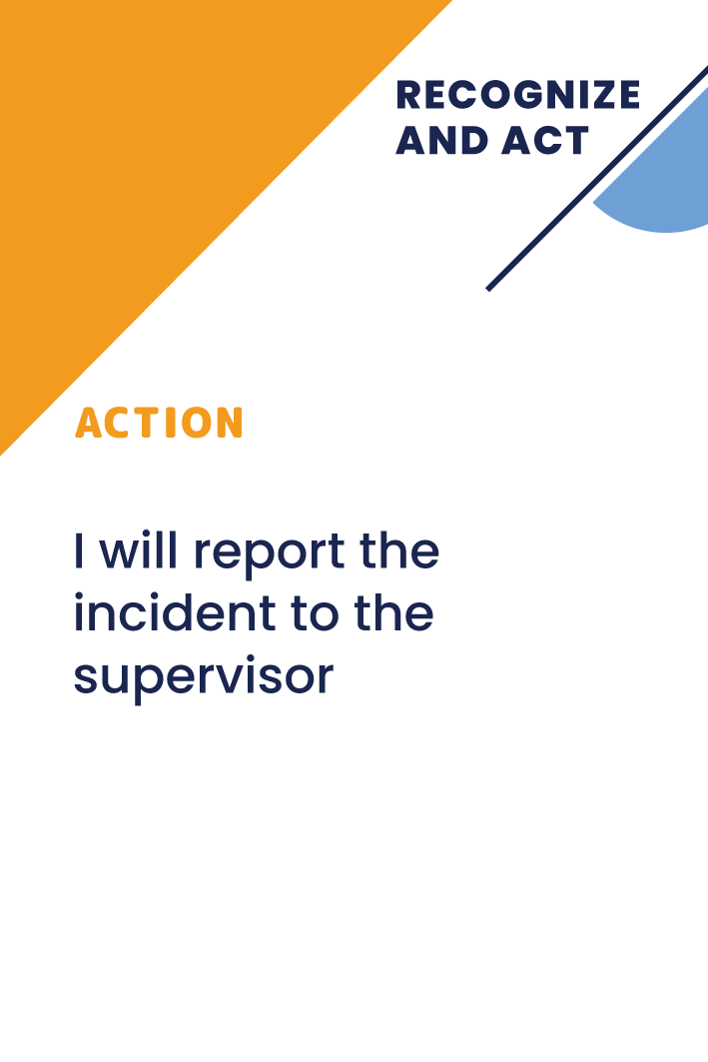


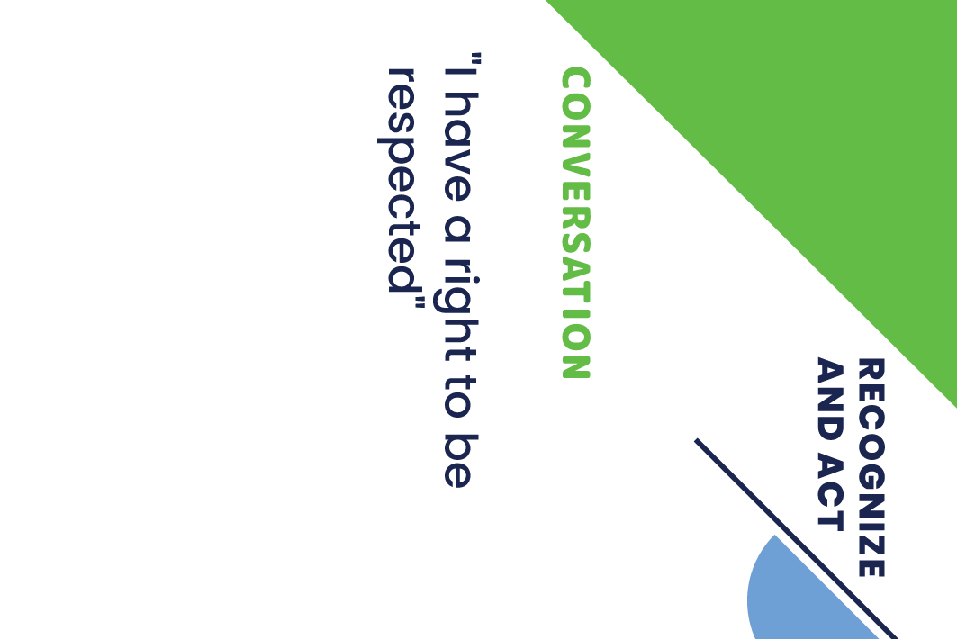
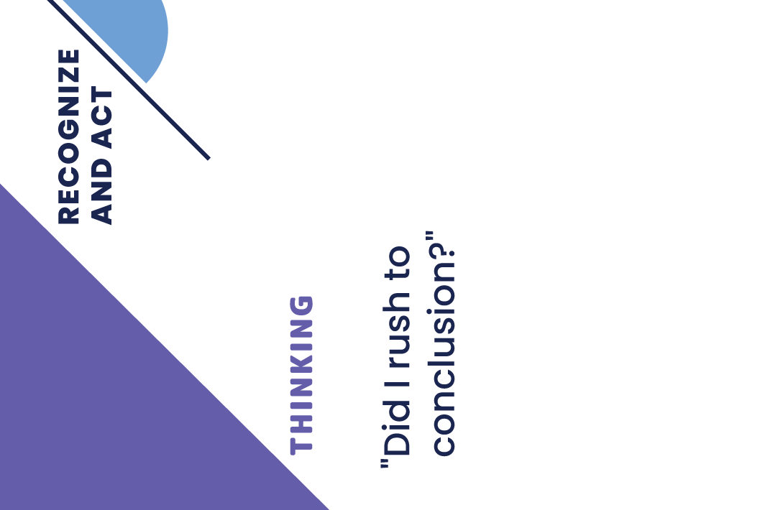
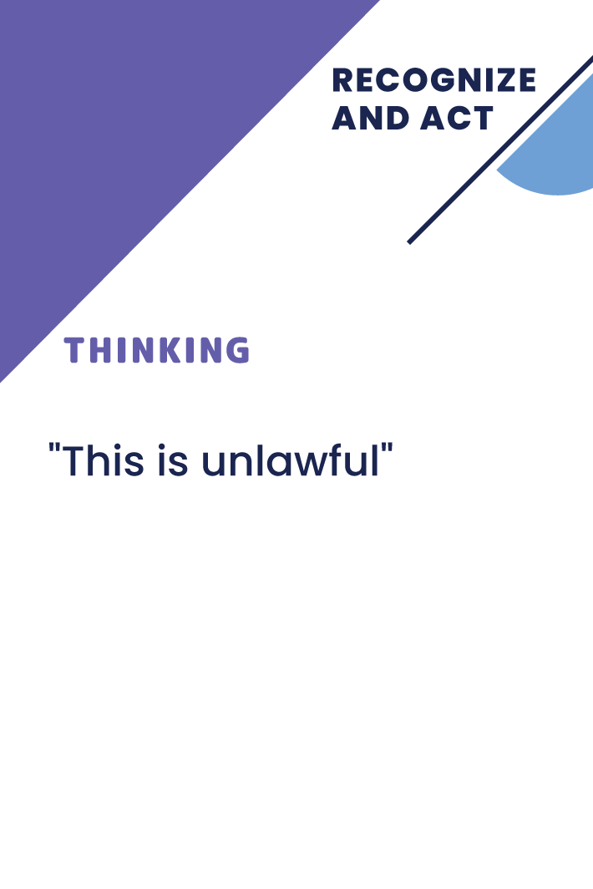
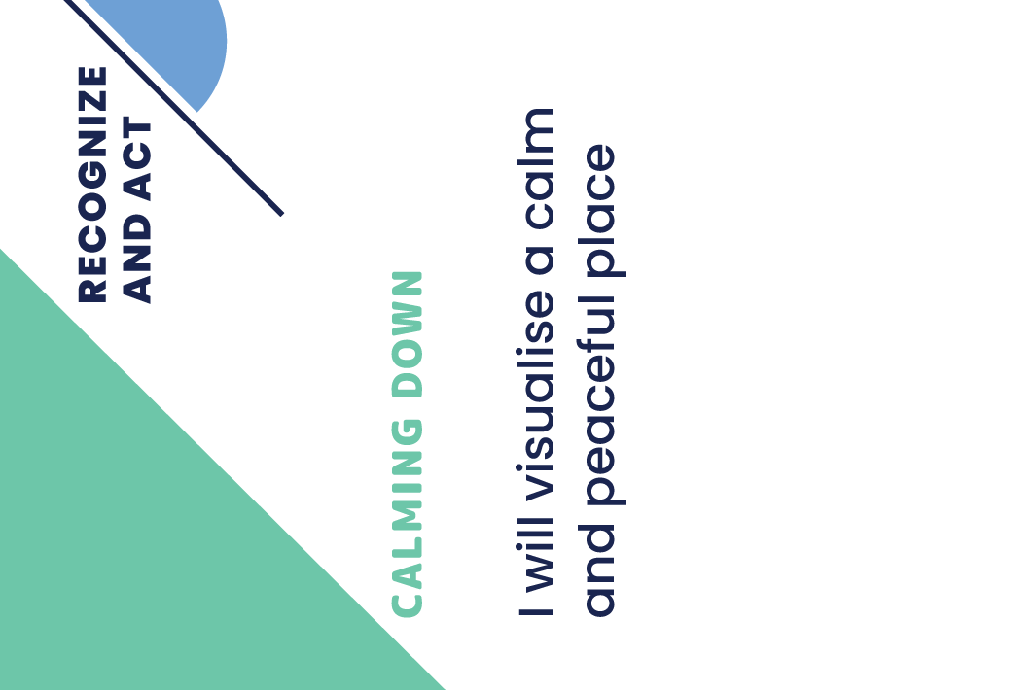
Notes:
“Duraks”

Slide 112
Group game
Preparing
Number of participants 2-6
Players sit in a circle at the table
The leader of the game mixes together
all four groups of solution cards and distributes
6 cards to each participant.
The remaining cards are placed face down
next to the situation card pile.
The first game leader is selected. The game
is led by all participants - each taking turns choosing
one situation card to analyse.

Slide 113
Group game
Playing
The first player chooses one situation from the pile
of situations and reads it. The situation can e adapted
to the specific work environment if needed.
The leader of the game invites each participant to find one card in their hands that would help solve the given situation.
Participants take turns laying down their cards, explaining
how a particular card can help solve the situation. The group discusses whether the solution is accepted or not. If opinions differ, the game leader has the final say.
If someone does not have a matching solution card, they take a new solution from the pile until they find a suitable solution.

Slide 114
Group game
Closing
After everyone has played their situation,
the played cards are put aside and the player
on the left of the game leader takes control
of the game
New solution cards are not taken - the game continues with the existing number of cards.
The game ends when a player runs out of cards

Slide 115
Group game
Some remarks
If the players see that someone is having trouble finding solutions, it is possible to play the game with cards opened, where all the players see everyone’s cards and they can help each other
This method is helpful to discuss why one
of the participants chooses not to play
a solution card - the reason could be either inflexible thinking or a different understanding
of the situation

Slide 116
2. game
Sociometry
Notes:
DURAKS

Slide 117

-10 -9 -8 -7 -6 -5 -4 -3 -2 -1 0 1 2 3 4 5 6 7 8 9 10

Slide 118
Sociometry
Preparing
Number of players – from 2 to 20 and according
to the capacity of the room
The game manager pre-selects 10-20 situations that are supposed to be analyzed during the game
It is recommended to supplement and adjust these situations according to the specific work environment, using the cards only as a suggestion for the ideas of the situations
A stress level scale from 0-10 or from -10 to +10
is created on the floor according to the capacity
of the premises

Slide 119
Sociometry
Play
The leader of the game reads the situation and invites the participants to evaluate how high their stress level would be in the given situation and show it on the scale.
The game leader can encourage on talk more about the choices made, especially if they
are very different in the group. This is a great
start for group discussions about occupational stress and how one copes with it.
-10 -9 -8 -7 -6 -5 -4 -3 -2 -1 0 1

Slide 120
Sociometry
Play
The game will reflect how each person reacts differently in each situation - what might be a huge source of stress for one person might be OK for another one.
Such discussions help to understand
the perspective of each player.

Slide 121
3. game
Sociometry for Individual Play
Notes:
DURAKS

Slide 122

-10 -9 -8 -7 -6 -5 -4 -3 -2 -1 0 1 2 3 4 5 6 7 8 9 10

Slide 123
Sociometry
Preparation and play
Number of players – 1 or 2
The player selects situations
and places them on a stress scale.
Once the situation is placed on the scale, the player can use the solution cards
to look for what could move the situation card to a lower stress level.
-10 -9 -8 -7 -6 -5 -4 -3 -2 -1 0 1

Slide 124
4. game
Resolve the Situation
Notes:
DURAKS

Slide 125

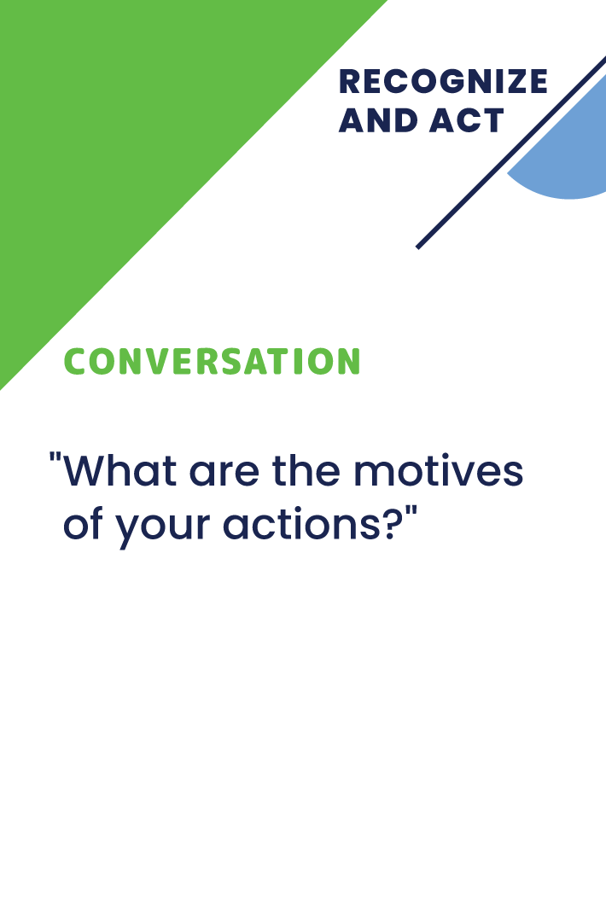

Slide 126
Resolve the Situation
Preparing
Number of players – 2-6
The leader of the game selects the situations to be discussed
Each player receives 3 cards from each solution group

Slide 127
Resolve the Situation
Play
The game leader reads the situation, explaining it in more detail and, if necessary, modifying or supplementing it according
to the situation of the organization
Each player takes turns laying down one solution card, explaining how that card
can help improve the situation.

Slide 128
Resolve the Situation
Play
The next player places his card, freely choosing where he thinks his solution should be and reads the entire sequence of solutions.
The next player places his card in
a place of his choice and reads the entire sequence of solutions.

Slide 129
Resolve the Situation
Closing
Game participants deploy solutions
as long as the group agrees that the specific situation has been resolved.
If the solution chain is very long,
it can be grouped.
The game has no winner, the purpose of the game is to initiate a discussion and show different possible solutions, groups of solutions and combinations.

Slide 130
5. game
Four Paths to Peace
Notes:
DURAKS

Slide 131



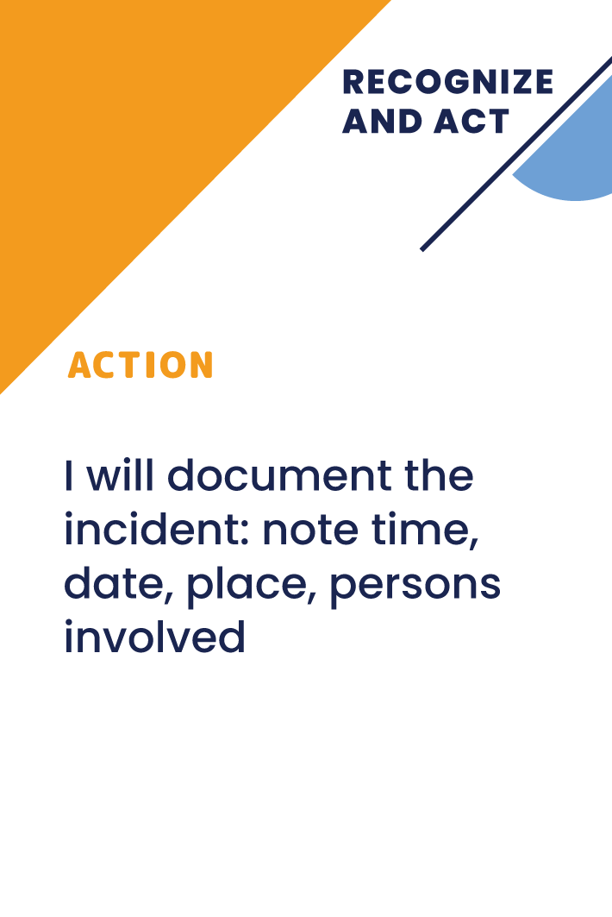



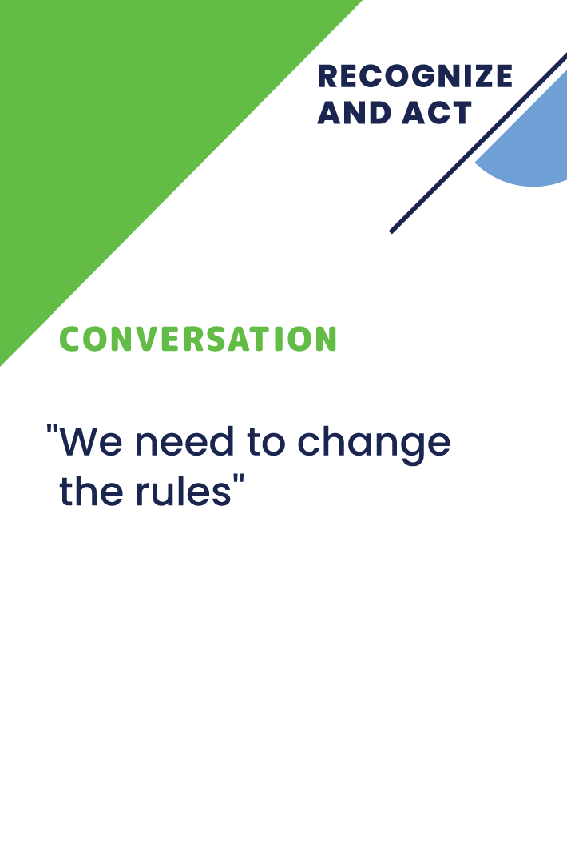
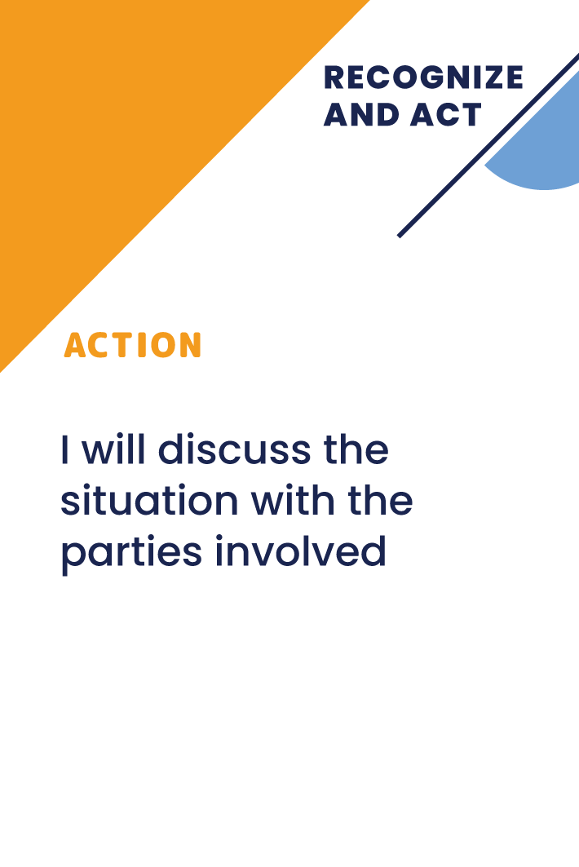

Slide 132
Four Paths to Peace
Preparing
Number of players – 1-6 or 2-6 groups (up to 6 participants in each group)
The leader of the game selects 1-3 situations to be discussed within the game.
It is recommended to adapt
the situations so that they sound appropriate for the organization.

Slide 133
Four Paths to Peace
Preparing
Before the game, the leader of the game selects 2-4 solutions from
each group of solutions and places them in the matrix:
Calming strategies
Thinking strategies
Negotiation strategies
Action strategies

Slide 134
Four Paths to Peace
Play
The player or players are introduced
to the specific situation.
The leader invites the participants to find the first priority solution, as well
as the second most suitable card
in each group of solutions
Players in groups or individually discuss solutions step by step and place the most suitable ones in order of priority

Slide 135
Four Paths to Peace
Closing
Each group presents its solution to the team in the order set - first I will calm down ...., then I will think ...., then I will say .... Then I will act….
The group can then discuss whether this order
is the most appropriate for the situation and how changing the sequence of cards changes the solution.
This game helps to discuss values ​​and priorities as well as processes and procedures.

Slide 136
6. game
Dominoes
Notes:
DURAKS

Slide 137
Notes:
“Domino”

Slide 138
Dominoes
Preparing
The leader of the game chooses a situation
to be addressed and explains it to the participants, applying it to the specific organization and situation.
The situation is placed in the middle
of a large table.
Solution cards mix all four groups together
Each player receives six solution cards. The remaining solution cards are placed nearby.

Slide 139
Dominoes
Play
Each participant in turn puts their solution, explaining how it sequentially helps the chain of solutions.
If there is no suitable card, the player draws from the face down pile
The group collectively agrees whether the solution is appropriate or not.

Slide 140
7. game
Choose the problem
Choose the solution
Notes:
DURAKS

Slide 141
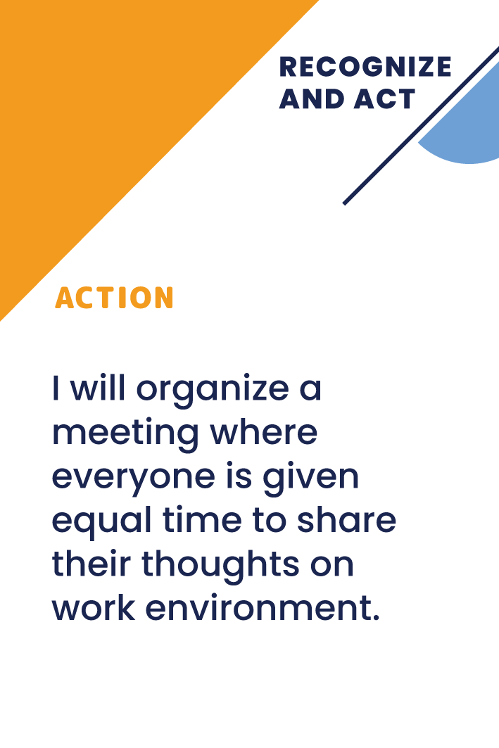
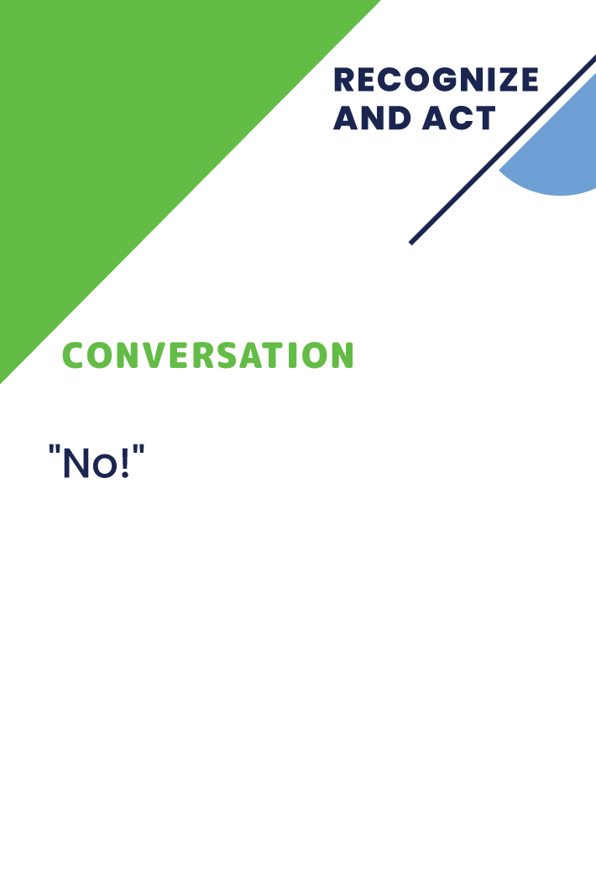

Slide 142
Choose the problem
Choose the solution
Preparing
Number of participants – 1- many
Each participant receives several solution cards (the number depends on the number of participants) and several problem situation cards
The leader of the game places one story card in the middle of the table and explains it, adjusting it according to the situation
of the specific organization if necessary.

Slide 143
Choose the problem
Choose the solution
Play
Each participant takes turns placing their solution cards if they see they have them.
Participants can place their cards randomly as the most important part is discussions and demonstration that there are different solutions for the each situation.

Slide 144
Choose the problem
Choose the solution
Closing
When all options are placed, the solution cards are randomly given back to the players and the next story card or solution card is placed in the middle of the table.
If a solution card is placed, the game players place appropriate story cards around it.
Be prepared that this type of game will initiate lots of discussion, but this is also the purpose of this game.

Slide 145
8. game
Create a story – yes, but…
Notes:
DURAKS

Slide 146
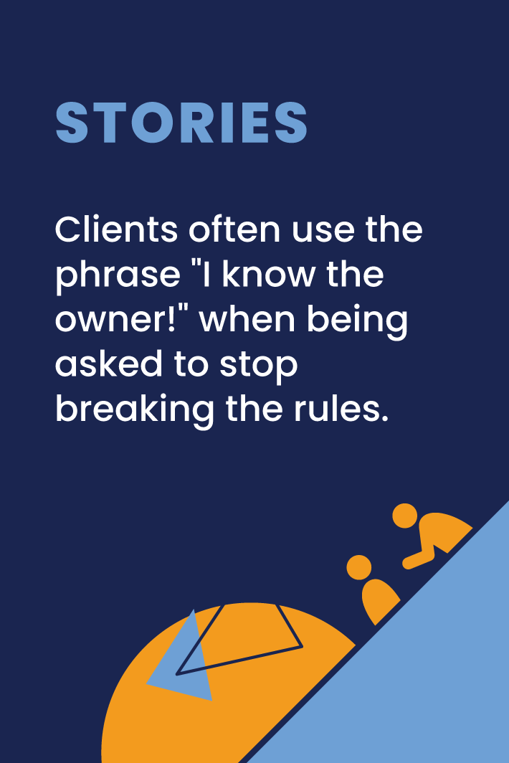
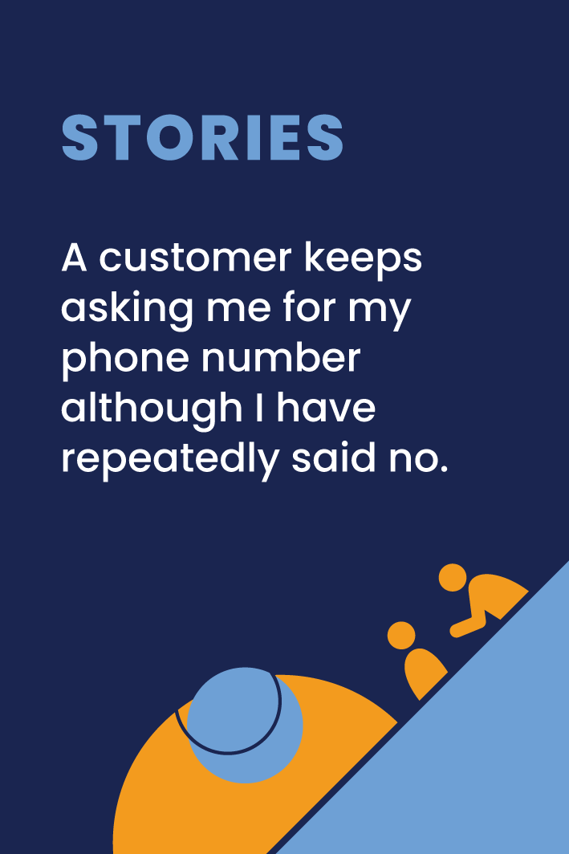
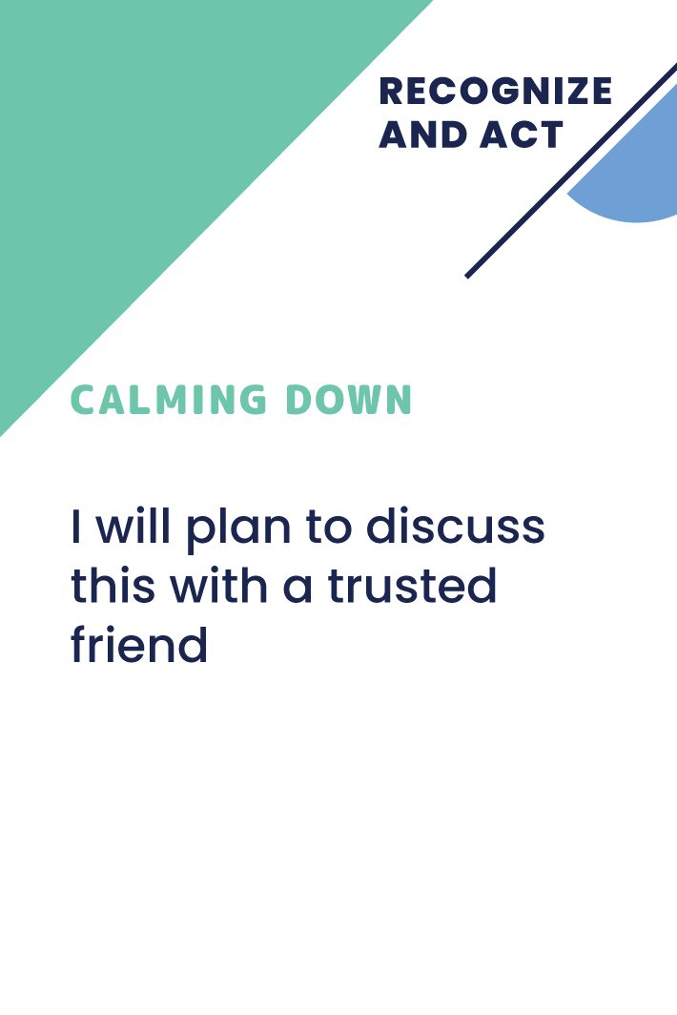
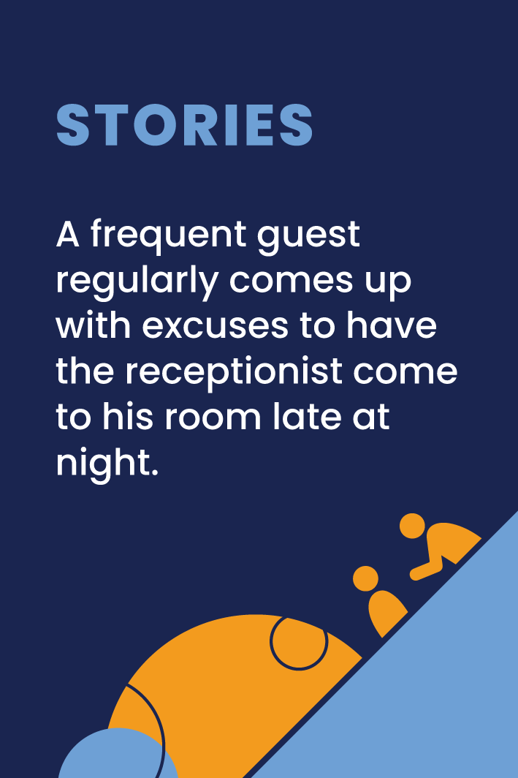
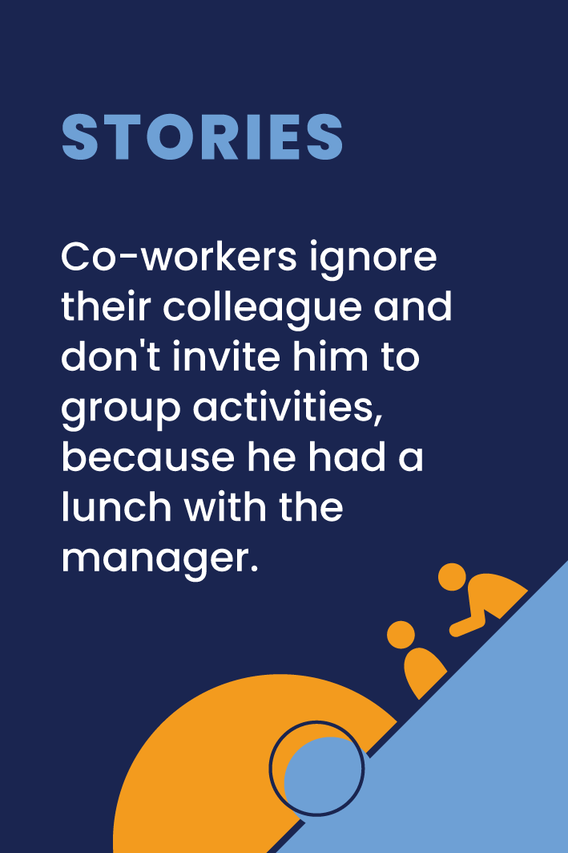


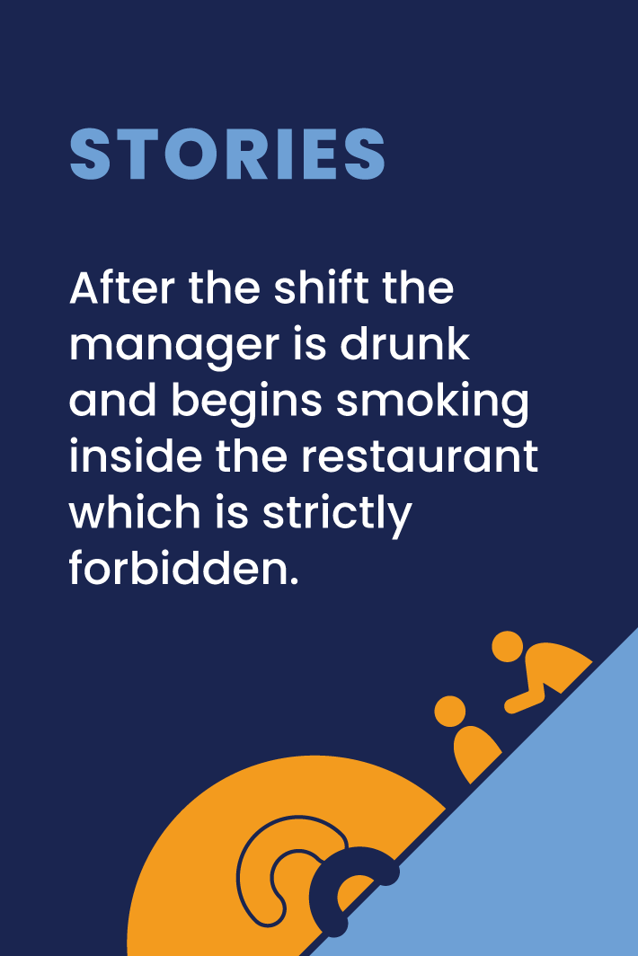
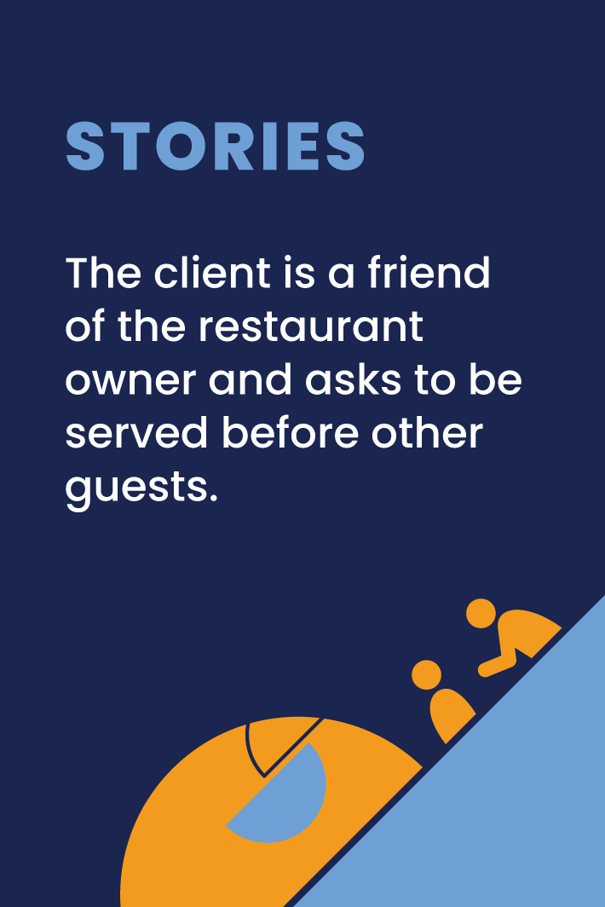


Slide 147
Create a story – yes, but…
Play
Each player receives one story card
and one solution card.
The leader of the game starts the story with the problemsituation and the next player continues
it either by adding "Yes" and mentioning the solution on his card or with "but" and mentioning the situation on the problem card.
The next player then continues the story.
They can change or adjust the texts written
in their cards.

Slide 148
Create a story – yes, but…
Play
The story finishes when the circle ends, or when everyone has played out their cards, or when players manage to logically finalize the story
This is a great game for ice breaking activities, team buliding activities
and for warming up.

