Slide 1
Apmācību plānošana: Terciārā prevencija (4)
Eiropas Komisijas atbalsts šīs publikācijas sagatavošanai nav uzskatāms par satura apstiprinājumu, kas atspoguļo tikai autoru viedokļus, un Komisija nevar būt atbildīga par tajā ietvertās informācijas jebkādu izmantošanu.

Slide 2
Tēmas
Terciārā prevencija
Kas ir terciārā prevencija
Monitoringa sistēma
Atbalsta iespējas cietušajai personai
Komandas dinamika
Kopsavilkums
1.uzdevums
2.uzdevums

Slide 3
Kas ir terciārā prevencija?
„Terciārās prevencijas mērķis ir novērst neapmierinošus uzņēmuma mērķus, kuru pamatā ir slikta vai vāji īstenota stratēģija“
Notes:
Primary prevention is education towards a healthy, prosperous company that develops its skills and manages stressful situations well. The maximum effort is to prevent and reduce the level of risks satisfied with certain manifestations of the company's bad strategy.

Slide 4
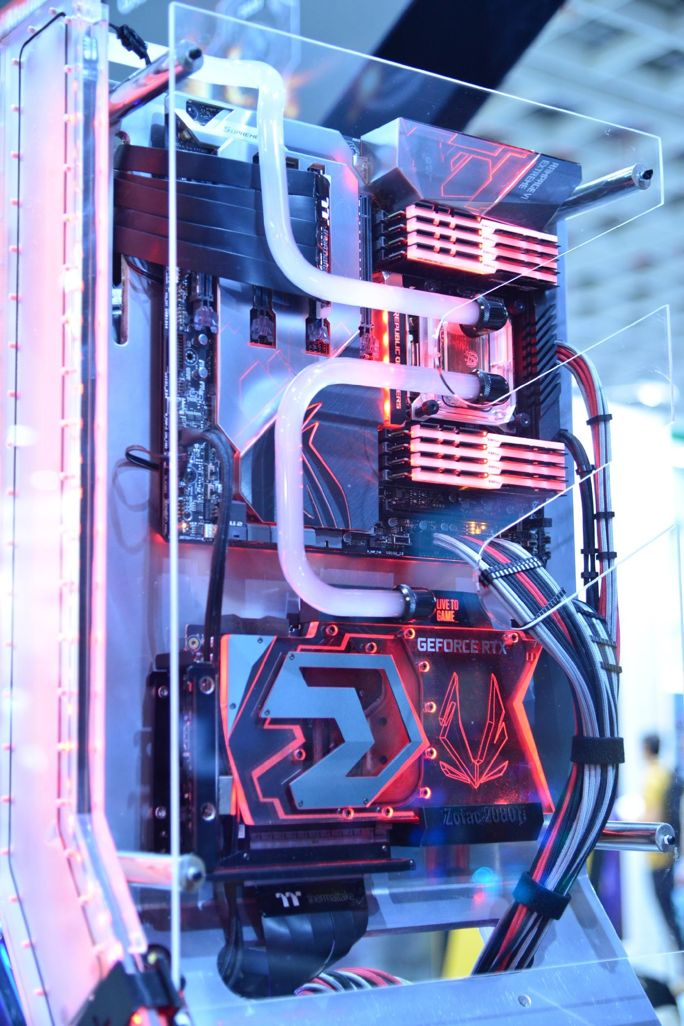
Monitoringa sistēma
novērtējumam
vadībai
atskaitēm
monitoringam
izmanto:
utt.
Notes:
Monitoring system
Monitoring system means, for example, an information system used for monitoring, management, evaluation and reporting of partial information that leads to company management.

Slide 5
Atbalsta iespējas cietušajai personai
pārkāpti drošības un veselības aizsardzības noteikumi
darbinieks kļūst invalīds
Notes:
Possibilities of support for the affected person
If there is a situation in the work process where the safety and health protection policy is violated, a situation occurs where the employee may become disabled. Although this situation is not ideal, it can happen in practice and the company should be prepared for it, therefore it should have a system or program to support the disabled.

Slide 6
Komandas dinamika
vairāk cilvēku to izdara labāk
”divas galvas ir labāka par vienu"
laba darba pamats
Notes:
Team dynamics
Good team dynamics in the workplace are the basis of good work. If you've been brought together with a group of individuals to tackle a project or break through a problem, you'll want to share the space with others who know they can handle themselves. If someone is very critical, or someone doesn't talk, or another person talks too much, these traits and attitudes can damage the project.
"Group or team dynamics" in the workplace usually implies the attitude of how people in different departments, groups, or offices, or simply individuals, come together in a group setting. People naturally fall into certain roles and behaviors that influence how everyone performs in that role and what behavior results from it. This affects both the individual and the group.

Slide 7
Kopsavilkums
ilgtermiņa rakcija uz radušos problēmu
problēmas ietekmes mazināšana
veselības un drošības atjaunošana
turpmākas vardarbības novēršana
novērst darbinieku mainību
novērst morāles pazemināšanos
novērst prombūtni
Notes:
Tertiary interventions involve longer-term responses after the problem has occurred to deal with lasting consequences, minimize its impact, restore health and safety and prevent further perpetration and victimisation. Tertiary interventions are relevant to workplace violence because of the significant negative psychological, health and job-related consequences that targets have been found to experience. Consistently demonstrated in previous work, these consequences range from anxiety to anger, powerlessness, depression and post-traumatic stress disorder, lower job satisfaction, commitment and productivity, and employment withdrawal.
Further illustrating the importance of tertiary intervention is that workplace violence poses longer term organizational consequences in terms of employee turnover, reduced morale, absenteeism, the cost of investigations and those arising from legal actions, damage to external reputation and loss of shareholder confidence.

Slide 8
1.uzdevums
(10 min.)
Komandā pārrunājiet, vai kāds personīgi ir saskāries ar terciāro vardarbības novēršanu darbavietā?

Slide 9
2.uzdevums
(10 min.)
Pamatojoties uz iepriekš minēto informāciju, ierosiniet, kādai vajadzētu būt šādai terciārajai profilaksei, kā tā būtu jāpiemēro, uz ko uzņēmumam būtu jākoncentrējas šajā jomā.

Slide 10
Atsauces
ARMSTRONG, M., 2007. Řízení lidských zdrojů: nejnovější trendy a postupy : 10. vydání. 1. vyd. Praha: Grada. ISBN 978-80-247-1407-3.
ATTEBYOVÁ S., 2021. Proč je zásadní vytvářet dobrou týmovou dynamiku na pracovišti? . [online] [vid. 2022-15-08]. Dostupné z: https://www.callbridge.com/cs/blog/good-team-dynamics-is-essential-in-the-workplace/
CRDR spol. s.r.o., 2017. Analýza a řízení rizik BOZP. Identifikace, hodnocení a management ve firmách a jiných organizacích. [online] [vid. 2022-15-08]. Dostupné z: https://www.dokumentacebozp.cz/aktuality/analyza-rizik-bozp-rizeni-hodnoceni-identifikace-management/
CRDR spol. s.r.o., 2022. Slovník pojmů z oblasti BOZP a PO. [online] [vid. 2022-15-08]. Dostupné z: https://www.bozp.cz/slovnik-pojmu/skoleni-bozp/
ČERNÝ, M., 2010. Základní úrovně provádění primární prevence. Tišnov: Sdružení SCAN.
DI MARTINO, V., HOEL, H., AND COOPER, C. L. (2003): Violence and harassment in the workplace: A review of the literature. European Foundation for the Improvement of Living and Working Conditions: Dublin
EDELMAN, L., ERLANGER, H. AND LANDE, J. (1993). ‘Internal dispute resolution: The transformation of civil rights in the workplace’. Law & Society Review, 27, 497-534.
EIB, 2018. Zásady mechanismu pro vyřizování stížností. [online] [vid. 2022-15-08]. Dostupné z: https://www.eib.org/attachments/strategies/complaints_mechanism_policy_cs.pdf
E.ON, 2015. Formulace politiky společnosti RU Česká republika v oblasti bezpečnosti práce, ochrany zdraví a životního prostředí. [online] [vid. 2022-15-08]. Dostupné z: https://www.egd.cz/sites/default/files/201902/Politika%20integrovan%C3%A9ho%20syst%C3%A9mu%20%C5%99%C3%ADzen%C3%AD.pdf
HOBSON, J.S.P. (1996): Violent crime in the US hospitality workplace: facing up to the problem. International Journal of Contemporary Hospitality Management, 8 (4), 3-10
HOEL H., AND EINARSEN, S. (2003): Violence at work in hotels, catering and tourism, available at: http://www.oit.org/wcmsp5/groups/public/@ed_dialogue/@sector/documents/publication/wcms_161998.pdf
HOFFMAN, E. (2005). ‘Dispute resolution in a worker cooperative: Formal procedures and procedural justice’. Law and Society Review, 39(1), 51–82.
KOŽENÁ J., 2009. Externí komunikace vytváří obraz vaší firmy v očích veřejnosti i médií. [online] [vid. 2022-15-08]. Dostupné z: https://www.vlastnicesta.cz/clanky/externi-komunikace-vytvari-obraz-vasi-firmy-v-o/

Slide 11
Atsauces
LIEBMANN, M. (2000). ‘History and overview of mediation in the UK’. In M. Liebmann (ed), Mediation in Context. London: Jessica Kingsley Publisher, 19-38.
MICELI, M., NEAR, J., AND MOREHEAD, DWORKIN T. (2008). ‘A word to the wise: how managers and policy-makers can encourage employees to report wrongdoing’. Journal of Business Ethics, 86, 379-396.
MIOVSKÝ, M., SKÁCELOVÁ, L., ZAPLETALOVÁ, J., NOVÁK, P. 2010. Primární prevence rizikového chování ve školství. Tišnov: Sdružení SCAN.
MŠMT, 2005. Standardy odborné způsobilosti poskytovatelů programů primární prevence užívání návykových látek. Praha: MŠMT.
MŠMT, 2010. Metodické doporučení k primární prevenci rizikového chování u dětí, žáků a studentů ve školách a školských zařízeních. [online] [vid. 2022-15-08]. Dostupné z: http://www.msmt.cz/socialni-programy/metodicke-doporuceni-k-primarni-prevenci-rizikoveho-chovani
OPPENHEIMER, A. (2004). ‘Investigating workplace harassment and discrimination’. Employee Relations Law Journal, 29(4), 56-68.
PLAMÍNEK, J., 2010. Tajemství motivace: jak zařídit, aby pro vás lidé rádi pracovali. 2., dopl. vyd. Praha: Grada. ISBN 9788024734477
RAYNER, C., HOEL, H. AND COOPER, C.L. (2002): Workplace Bullying: What we know, who is to blame, and what can we do? London: Taylor and Francis
SALIN, D. (2007). ‘Organizational responses to workplace harassment: an exploratory study’. Personnel Review, 38(1), 26-44.
SCHEU L., 2021. Násilí na pracovišti: peer pracovník jako možná cesta ochrany zaměstnanců? [online] [vid. 2022-15-08]. Dostupné z: https://www.bozpinfo.cz/josra/nasili-na-pracovisti-peer-pracovnik-jako-mozna-cesta-ochrany-zamestnancu
SMITHSON, L., 2006. An infographic depiction of all things motivation in the workplace. IncBlot. [online] [vid. 2022-05-05]. Dostupné z: https://visual.ly/community/Infographics/business/incblot-motivation-infographic
ŠNAJDR I., 2013. Svizí, strategií a polotikou. [online] [vid. 2022-15-08]. Dostupné z: https://www.snajdr.com/jak-pracujeme/s-vizi-strategii-a-politikou/
WALKER, B. AND HAMILTON, R. T. (2011). ‘Employee-employer grievances: a review’. International Journal of Management Reviews, 13(1) 40-58.

Slide 12
Paldies par uzmanību

Slide 13
Projekta partneri
DEKAPLUS
Cyprus
Czech University of Life Sciences Prague Czech Republic
DIAS Greece
OUT LOUD
Latvia
Social Innovation Fund Lithuania
Pancyprian Association of Hotel Managers Cyprus
Beneke & Prinzhorn GmbH Germany
https://www.weedout.eu/

