Slide 1
Training Design: Tertiary Prevention (4)
The European Commission's support for the production of this publication does not constitute an endorsement of the contents, which reflect the views only of the authors, and the Commission cannot be held responsible for any use which may be made of the information contained therein.

Slide 2
Topics
Secondary prevention
What is tertiary prevention
Monitoring system
Possibilities of support for the affected person
Team dynamics
Summary
Task1
Task2

Slide 3
What is tertiary prevention
„The objective of tertiary prevention is the prevention of unsatisfactory company goals, based on a bad or poorly implemented strategy.“
Notes:
Primary prevention is education towards a healthy, prosperous company that develops its skills and manages stressful situations well. The maximum effort is to prevent and reduce the level of risks satisfied with certain manifestations of the company's bad strategy.

Slide 4
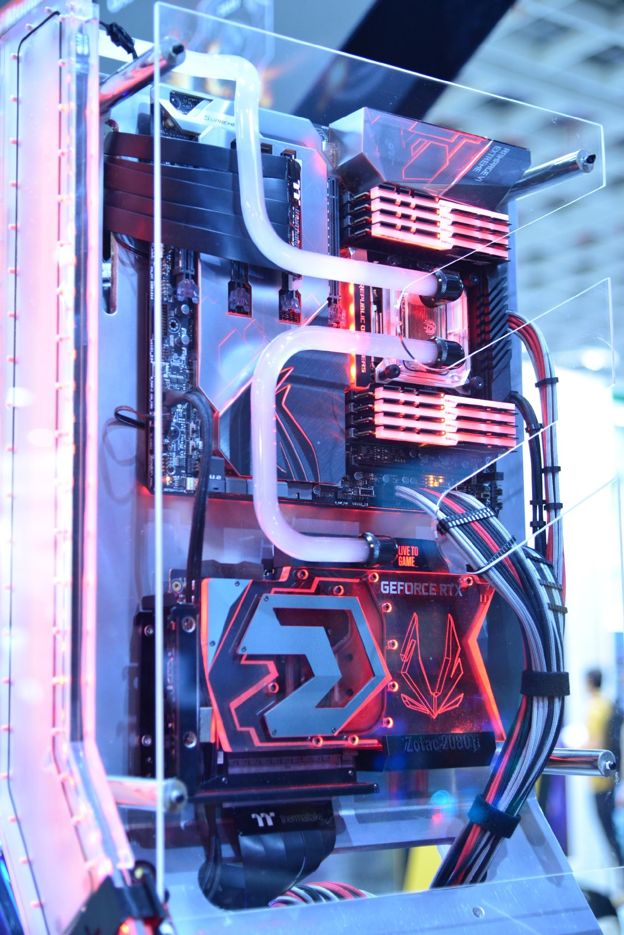
Monitoring system
evaluation
management
reporting
monitoring
use for:
etc.
Notes:
Monitoring system
Monitoring system means, for example, an information system used for monitoring, management, evaluation and reporting of partial information that leads to company management.

Slide 5
Possibilities of support for affected person
health and safety policy violated
disabled employee
Notes:
Possibilities of support for the affected person
If there is a situation in the work process where the safety and health protection policy is violated, a situation occurs where the employee may become disabled. Although this situation is not ideal, it can happen in practice and the company should be prepared for it, therefore it should have a system or program to support the disabled.

Slide 6
Team dynamics
it goes better with more people
"two heads are better than one"
the basis of good work
Notes:
Team dynamics
Good team dynamics in the workplace are the basis of good work. If you've been brought together with a group of individuals to tackle a project or break through a problem, you'll want to share the space with others who know they can handle themselves. If someone is very critical, or someone doesn't talk, or another person talks too much, these traits and attitudes can damage the project.
"Group or team dynamics" in the workplace usually implies the attitude of how people in different departments, groups, or offices, or simply individuals, come together in a group setting. People naturally fall into certain roles and behaviors that influence how everyone performs in that role and what behavior results from it. This affects both the individual and the group.

Slide 7
Summary
longer-term response to the problem that has arisen
minimizing the impact of the problem
restoring health and safety
prevent further violence
prevent employee turnover
prevent lowering of morale
prevent absence
Notes:
Tertiary interventions involve longer-term responses after the problem has occurred to deal with lasting consequences, minimize its impact, restore health and safety and prevent further perpetration and victimisation. Tertiary interventions are relevant to workplace violence because of the significant negative psychological, health and job-related consequences that targets have been found to experience. Consistently demonstrated in previous work, these consequences range from anxiety to anger, powerlessness, depression and post-traumatic stress disorder, lower job satisfaction, commitment and productivity, and employment withdrawal.
Further illustrating the importance of tertiary intervention is that workplace violence poses longer term organizational consequences in terms of employee turnover, reduced morale, absenteeism, the cost of investigations and those arising from legal actions, damage to external reputation and loss of shareholder confidence.

Slide 8
Task 1
(10 min.)
As a team, discuss if anyone has personally encountered tertiary prevention of workplace violence?

Slide 9
Task 2
(10 min.)
Based on the mentioned information, suggest what such tertiary prevention should look like, how it should be applied, what the company should focus on in this area.

Slide 10
References
ARMSTRONG, M., 2007. Řízení lidských zdrojů: nejnovější trendy a postupy : 10. vydání. 1. vyd. Praha: Grada. ISBN 978-80-247-1407-3.
ATTEBYOVÁ S., 2021. Proč je zásadní vytvářet dobrou týmovou dynamiku na pracovišti? . [online] [vid. 2022-15-08]. Dostupné z: https://www.callbridge.com/cs/blog/good-team-dynamics-is-essential-in-the-workplace/
CRDR spol. s.r.o., 2017. Analýza a řízení rizik BOZP. Identifikace, hodnocení a management ve firmách a jiných organizacích. [online] [vid. 2022-15-08]. Dostupné z: https://www.dokumentacebozp.cz/aktuality/analyza-rizik-bozp-rizeni-hodnoceni-identifikace-management/
CRDR spol. s.r.o., 2022. Slovník pojmů z oblasti BOZP a PO. [online] [vid. 2022-15-08]. Dostupné z: https://www.bozp.cz/slovnik-pojmu/skoleni-bozp/
ČERNÝ, M., 2010. Základní úrovně provádění primární prevence. Tišnov: Sdružení SCAN.
DI MARTINO, V., HOEL, H., AND COOPER, C. L. (2003): Violence and harassment in the workplace: A review of the literature. European Foundation for the Improvement of Living and Working Conditions: Dublin
EDELMAN, L., ERLANGER, H. AND LANDE, J. (1993). ‘Internal dispute resolution: The transformation of civil rights in the workplace’. Law & Society Review, 27, 497-534.
EIB, 2018. Zásady mechanismu pro vyřizování stížností. [online] [vid. 2022-15-08]. Dostupné z: https://www.eib.org/attachments/strategies/complaints_mechanism_policy_cs.pdf
E.ON, 2015. Formulace politiky společnosti RU Česká republika v oblasti bezpečnosti práce, ochrany zdraví a životního prostředí. [online] [vid. 2022-15-08]. Dostupné z: https://www.egd.cz/sites/default/files/201902/Politika%20integrovan%C3%A9ho%20syst%C3%A9mu%20%C5%99%C3%ADzen%C3%AD.pdf
HOBSON, J.S.P. (1996): Violent crime in the US hospitality workplace: facing up to the problem. International Journal of Contemporary Hospitality Management, 8 (4), 3-10
HOEL H., AND EINARSEN, S. (2003): Violence at work in hotels, catering and tourism, available at: http://www.oit.org/wcmsp5/groups/public/@ed_dialogue/@sector/documents/publication/wcms_161998.pdf
HOFFMAN, E. (2005). ‘Dispute resolution in a worker cooperative: Formal procedures and procedural justice’. Law and Society Review, 39(1), 51–82.
KOŽENÁ J., 2009. Externí komunikace vytváří obraz vaší firmy v očích veřejnosti i médií. [online] [vid. 2022-15-08]. Dostupné z: https://www.vlastnicesta.cz/clanky/externi-komunikace-vytvari-obraz-vasi-firmy-v-o/

Slide 11
References
LIEBMANN, M. (2000). ‘History and overview of mediation in the UK’. In M. Liebmann (ed), Mediation in Context. London: Jessica Kingsley Publisher, 19-38.
MICELI, M., NEAR, J., AND MOREHEAD, DWORKIN T. (2008). ‘A word to the wise: how managers and policy-makers can encourage employees to report wrongdoing’. Journal of Business Ethics, 86, 379-396.
MIOVSKÝ, M., SKÁCELOVÁ, L., ZAPLETALOVÁ, J., NOVÁK, P. 2010. Primární prevence rizikového chování ve školství. Tišnov: Sdružení SCAN.
MŠMT, 2005. Standardy odborné způsobilosti poskytovatelů programů primární prevence užívání návykových látek. Praha: MŠMT.
MŠMT, 2010. Metodické doporučení k primární prevenci rizikového chování u dětí, žáků a studentů ve školách a školských zařízeních. [online] [vid. 2022-15-08]. Dostupné z: http://www.msmt.cz/socialni-programy/metodicke-doporuceni-k-primarni-prevenci-rizikoveho-chovani
OPPENHEIMER, A. (2004). ‘Investigating workplace harassment and discrimination’. Employee Relations Law Journal, 29(4), 56-68.
PLAMÍNEK, J., 2010. Tajemství motivace: jak zařídit, aby pro vás lidé rádi pracovali. 2., dopl. vyd. Praha: Grada. ISBN 9788024734477
RAYNER, C., HOEL, H. AND COOPER, C.L. (2002): Workplace Bullying: What we know, who is to blame, and what can we do? London: Taylor and Francis
SALIN, D. (2007). ‘Organizational responses to workplace harassment: an exploratory study’. Personnel Review, 38(1), 26-44.
SCHEU L., 2021. Násilí na pracovišti: peer pracovník jako možná cesta ochrany zaměstnanců? [online] [vid. 2022-15-08]. Dostupné z: https://www.bozpinfo.cz/josra/nasili-na-pracovisti-peer-pracovnik-jako-mozna-cesta-ochrany-zamestnancu
SMITHSON, L., 2006. An infographic depiction of all things motivation in the workplace. IncBlot. [online] [vid. 2022-05-05]. Dostupné z: https://visual.ly/community/Infographics/business/incblot-motivation-infographic
ŠNAJDR I., 2013. Svizí, strategií a polotikou. [online] [vid. 2022-15-08]. Dostupné z: https://www.snajdr.com/jak-pracujeme/s-vizi-strategii-a-politikou/
WALKER, B. AND HAMILTON, R. T. (2011). ‘Employee-employer grievances: a review’. International Journal of Management Reviews, 13(1) 40-58.

Slide 12
Thank you for your attention

Slide 13
Project partners
DEKAPLUS
Cyprus
Czech University of Life Sciences Prague Czech Republic
DIAS Greece
OUT LOUD
Latvia
Social Innovation Fund Lithuania
Pancyprian Association of Hotel Managers Cyprus
Beneke & Prinzhorn GmbH Germany
https://www.weedout.eu/

