Slide 1
Gender considerations and intercultural management in understanding occupational violence (2)
The European Commission's support for the production of this publication does not constitute an endorsement of the contents, which reflect the views only of the authors, and the Commission cannot be held responsible for any use which may be made of the information contained therein.

Slide 2
Units
1. History and developments of the labour market and its relation to gender inequalities in the workplace
2. Gender-specific characteristics at management level - at the workplace
3. Micro- and power politics in organisations
4. Definition and differentiation between stereotypes, prejudices and clichés

Slide 3
Learning Outcomes
1. He/she is able to differentiate between stereotypes, prejudices and clichés.
2. He/ she is able to identify gender-specific characteristics in the working context in specific on the management level.
3. He/ she is able to cope with micro- and power political dynamics in the organization.

Slide 4
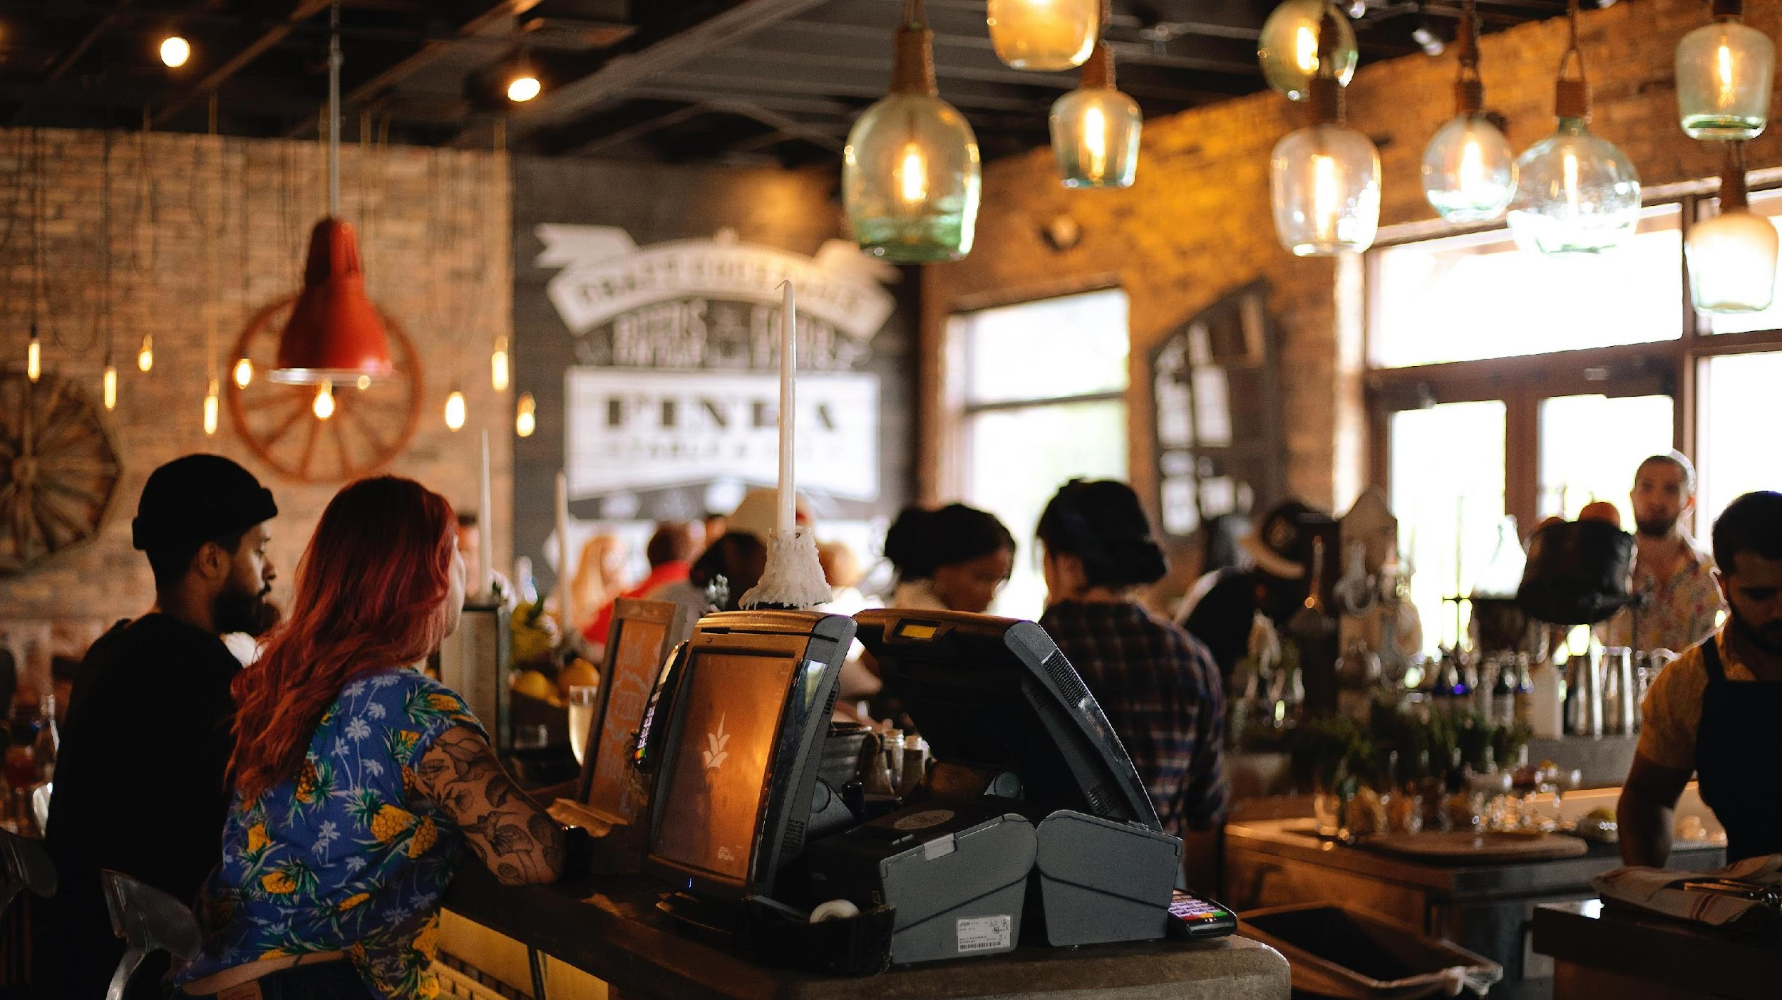
General overview
Unit 2
1st Module consists of 2 Units
Unit 1: History of the labour market and gender inequalities in the workplace
The history of the development of the labor market, its definitions, the gradual involvement and participation of women in the labor market are reviewed.
Unit 2: Gender-specific characteristics at management level, micro- and power political dynamics in the organization
Gender-specific characteristics at management level - at the workplace

Slide 6
Proportion of senior management roles held by women over the past five years
Notes:
https://www.grantthornton.global/en/insights/women-in-business-2021/
6

Slide 7
Women in Management, 2022
Women’s senior leadership roles are also shifting
https://www.catalyst.org/research/women-in-management/
Women leaders are still more likely to be HR directors;
In recent years, the proportion of women in other leadership roles like CEO, Chief Finance Officer, and Chief Information Officer has increased.(Women in business, 2021, https://www.grantthornton.global/en/insights/women-in-business-2021/)
In 2021, 26% of all CEOs and managing directors were women, compared to only 15% in 2019.⁵
The Fortune Global 500 reported an all-time high of 23 women CEOs in 2021, including six women of color.
Notes:
https://www.catalyst.org/research/women-in-management/
Hinchliffe, E. (2021). The number of women running Global 500 businesses soars to an all-time high. Fortune.
7

Slide 8
Women Dominate the Restaurant Workforce, Except at the Top
CEO Women in hospitality sector
Norway is the first country worldwide to adopt a 40% quota for female board members which came effective in 2008
Other West European countries followed, promoting mandatory quotas (e.g. Germany, France) or voluntary ones (e.g. UK, Sweden), with goals for female representation ranging from 25 to 40%
Notes:
Sowon Kim, Giuliano Bianchi, Maria José Bosch (2020). An Examination of the Impact of Macro Context on Women CEOs in the Hospitality Industry. // in The New Ideal Worker (pp.251-265). https://www.researchgate.net/publication/334113553_An_Examination_of_the_Impact_of_Macro_Context_on_Women_CEOs_in_the_Hospitality_Industry
https://www.businesstravelnews.com/Lodging/Survey-Shows-Incremental-Rise-of-Women-to-Hospitality-C-Suites
https://www.regiotels.com/women-and-the-hospitality-industry/
HTTPS://WWW.RESTAURANTBUSINESSONLINE.COM/WORKFORCE/WOMEN-DOMINATE-RESTAURANT-WORKFORCE-EXCEPT-TOP

Slide 9
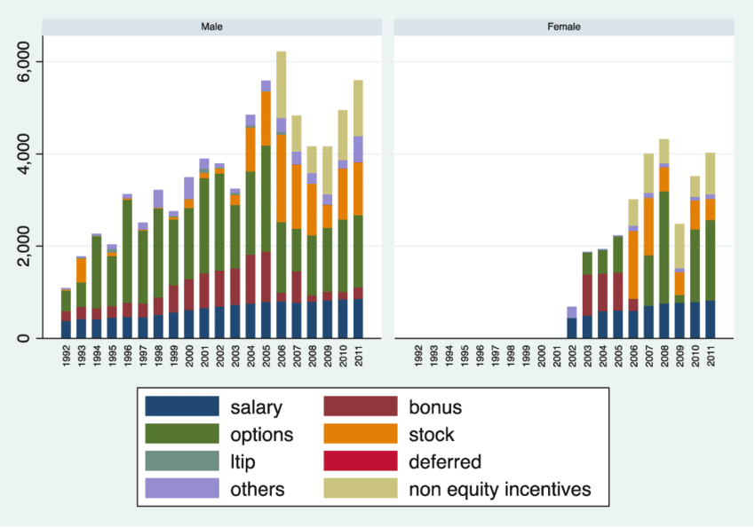
Average CEO compensation by gender in the hospitality industry (in thousands of USD)
Notes:
https://www.researchgate.net/figure/Average-CEO-compensation-by-gender-in-the-hospitality-industry-in-thousands-of-USD_fig1_334113553
In Sowon Kim, Giuliano Bianchi, Maria José Bosch (2020). An Examination of the Impact of Macro Context on Women CEOs in the Hospitality Industry. // in The New Ideal Worker (pp.251-265). researchgate.net/publication/334113553_An_Examination_of_the_Impact_of_Macro_Context_on_Women_CEOs_in_the_Hospitality_Industry

Slide 10
Accelerate Progress for Women
Research show:
female CEOs increase the social performance of organizations
Women CEOs are less overconfident than men , which is a trait that is positively associated with a crisis
Women’s economic participation and leadership are essential to driving business performance and achieving gender balance on corporate boards
Notes:
https://www.researchgate.net/publication/334113553_An_Examination_of_the_Impact_of_Macro_Context_on_Women_CEOs_in_the_Hospitality_Industry
Female CEOs increase the social performance of organizations (Jalbert et al. 2013).
Women CEOs are less overconfident than men (Huang and Kisgen 2013), which is a trait that is positively associated with a crisis (Ho et al. 2016; Kim et al. 2016).(p. 254)
https://www.catalyst.org/research/women-leadership-sp-tsx/
Women’s economic participation and leadership are essential to driving business performance and achieving gender balance on corporate boards
Key Findings:
Companies in the S&P/ TSX Composite Index have made progress for women on boards: In 2019, women comprised 27.6% of board directors, vs. 18.3% in 2015.
There is more work to be done, however, to advance progress for women on executive teams. From 2015 to 2019, the percentage of women on executive teams among S&P/ TSX Composite Index companies increased only from 15.0% to 17.9%.
As of August 2019—for the first time in its history—every company in the S&P/ TSX Composite Index had at least one woman on its board.
GenDiv book (SIF)

Slide 11
General overview
Unit 3
1st Module consists of 2 Units
Unit 1: History of the labour market and gender inequalities in the workplace
The history of the development of the labor market, its definitions, the gradual involvement and participation of women in the labor market are reviewed.
Unit 2: Gender-specific characteristics at management level, micro- and power political dynamics in the organization
Definition and differentiation between stereotypes, prejudices and clichés

Slide 12
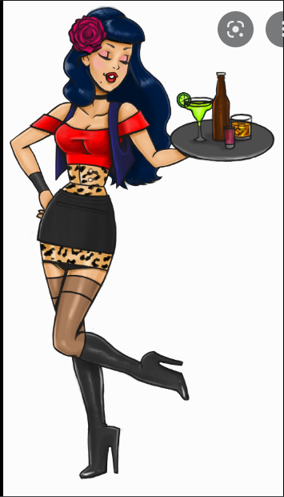
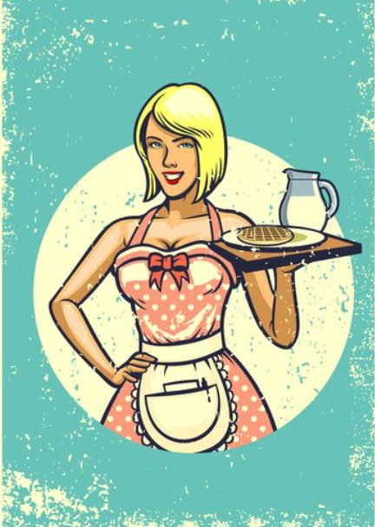
STEREOTYPES
A stereotype is a thought that someone has about specific types of individuals that may or may not accurately reflect reality.
Stereotypes can also be thought of like caricatures, which are pictures that exaggerate certain features.
Waitress
Cook

Slide 13
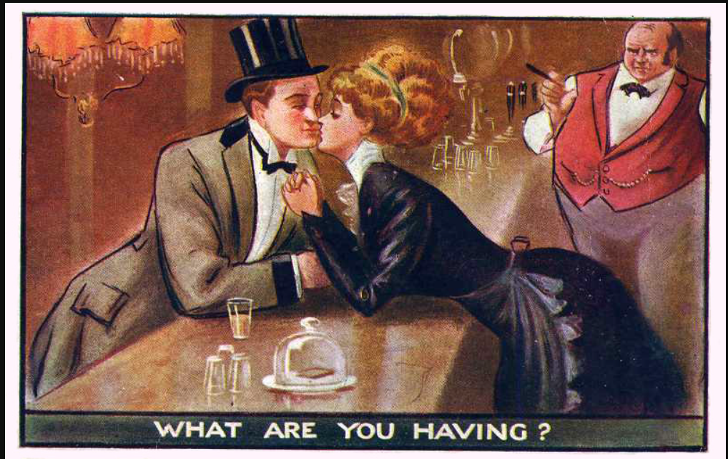
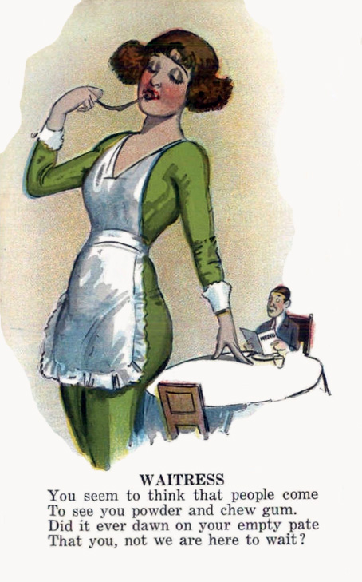
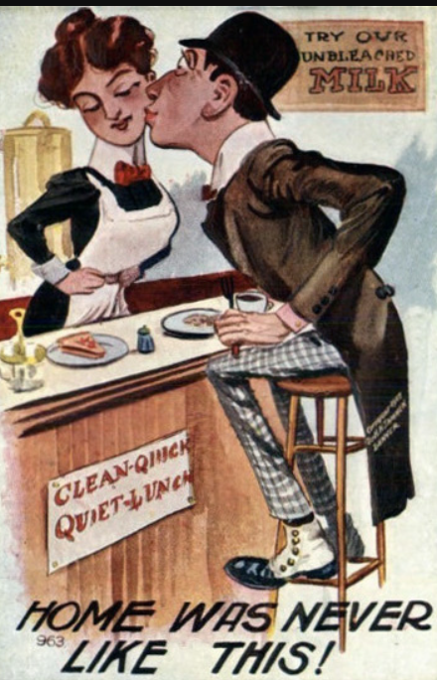
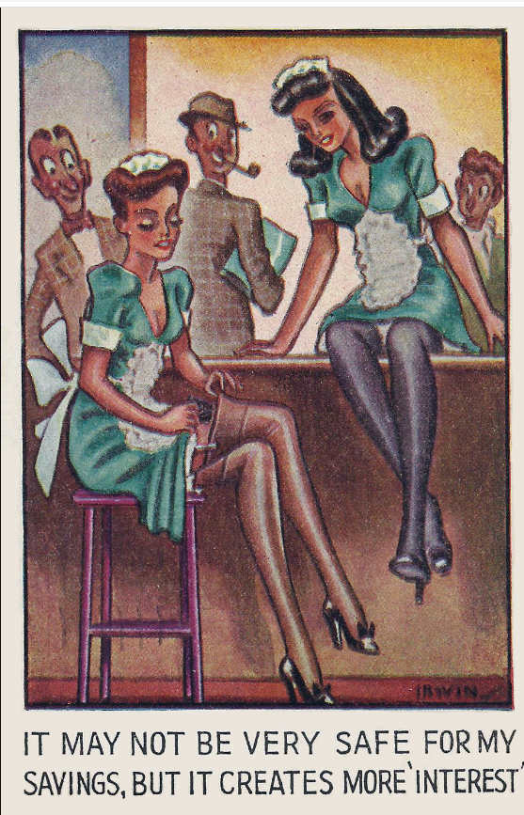
Stereotypes historically
Images in from 1906 to about 1915
Almost all joke postcards derived humor from insulting others, whether women, Blacks, immigrants, or the poor. On several of the cards in the post, the women illustrated are Irish immigrants, a status that was generally portrayed as both stupid and ugly.
Notes:
Restaurant-ing through history / Image gallery: insulting waitresses
https://restaurant-ingthroughhistory.com/tag/immigrant-waitresses/
Judging from postcards and cartoons, the early 20th century was not a fun time to be a waitress. However hard working, competent, or skilled in dealing with demanding situations they may have been [see recent op-ed on how much skill serving takes], there was no recognition of that in popular images.
Quite the contrary. The images were of two basic types. Either female servers were shown as incompetent or as objects of fantasy who were open to the sexual advances of their customers.
All but two of these images in this post are from 1906 to about 1915. The gum chewer is from the 1920s.
The reasons for these degrading images could be many. Joke-style postcards were designed to get men to send postcards, an activity that they were less inclined to do than were women. Almost all joke postcards derived humor from insulting others, whether women, Blacks, immigrants, or the poor. On several of the cards in the post, the women illustrated are Irish immigrants, a status that was generally portrayed as both stupid and ugly. Women who were in the public eye, such as actresses, department store clerks, or restaurant workers, were evidently considered fair game, possibly out of resentment that they strayed outside the realm of church and home or because they appeared in public without male protection.
Later postcards mostly dropped the theme of incompetence but images of sexy bimbo waitresses persisted for decades, as for example on this postcard mailed in 1946.

Slide 14
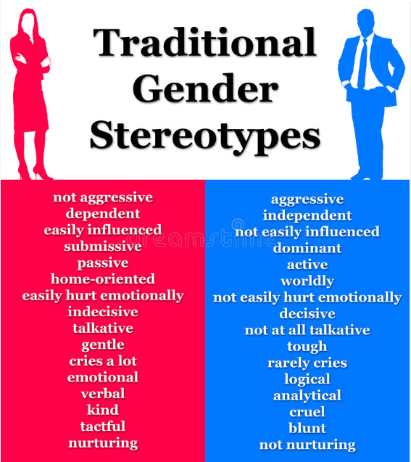

Slide 15
CLICHÉS and PREJUDICE
Cliches are terms, phrases, or even ideas that, upon their inception, may have been striking and thought-provoking but became unoriginal through repetition and overuse.
A prejudice is an opinion - usually an unfavorable one - that was formed before having any evidence and that is not based on reason or experience.
Notes:
Origin of the Word Cliché
The word cliché has French origins, which is why you'll often see it with an accent over the "e," but you can also write it as "cliche" in English. When printing presses were used, the cast iron plate that reproduced the words, phrases, or images was called a stereotype. The noise that casting plate made sounded like “cliché,” meaning click, to French printers, so this onomatopoeia word became printer’s jargon for the stereotype. Thus, cliché came to mean a word or phrase that gets repeated often.
Just because a phrase is overused doesn't mean it's a cliché, and because a phrase is a cliché doesn't mean it isn't true. A cliché conveys an idea or message but loses its point through over-usage. We'll let you be the judge of these examples of clichés you'll find in everyday use.

Slide 16
Micro- and power politics in organizations
Unit 4

Slide 17
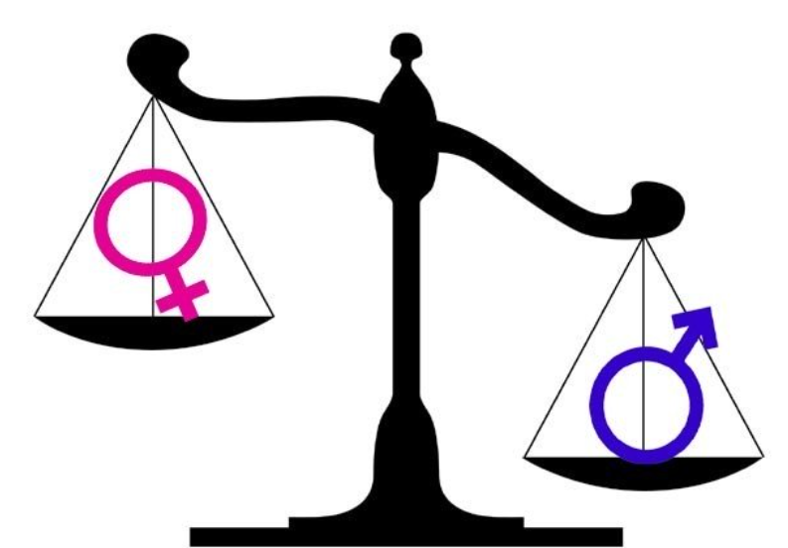
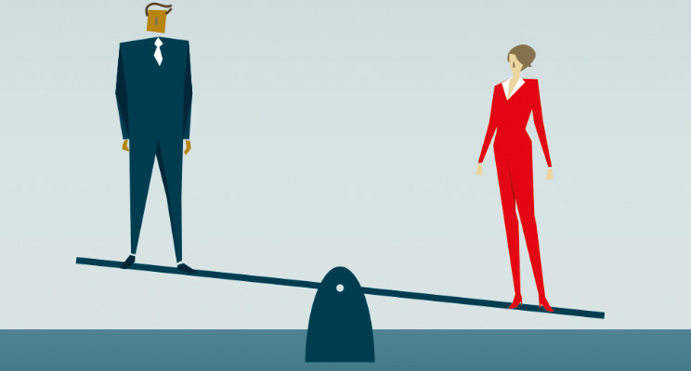
Micro- and power politics in organizations
Dominant gender norms are underpinned by unequal conceptions of status and power differentials
It become further emphasized at the intersections with other differences – serving to legitimize violence.
Often relationships between men and women are marred by power imbalances due to a combination of gender, social and cultural factors as well as individual childhood wounding.
Notes:
Gender matters: Rethinking violence in tourism. Annals of Tourism Research, J o u r n a l h o m e p a g e : h t t p s : / / w w w . j o u r n a l s . e l s e v i e r . c o m / a n n a l s - o f -t o u r i s m - r e s e a r c h https://www.sciencedirect.com/science/article/pii/S0160738321000050#bbb0075
Harvard Business Review, Power and Politics in Organizational Life
https://hbr.org/1970/05/power-and-politics-in-organizational-life

Slide 18
Particularities in tourism promotion
In tourism promotion, women are often depicted as sexual object for men.
Violence and harassment – sexual or moral – comes about in workplaces where, unequal power relationships predominate, work organisation and management are deficient, and corporate culture has been contaminated by poor interpersonal relationships.
There are also spaces of empowerment and resistance created within the practice of tourism, challenging stereotyped notions of femininity and masculinity.
Notes:
Annals of Tourism Research, Volume 88, May 2021, 103143
Gender matters: Rethinking violence in tourism (https://www.sciencedirect.com/science/article/pii/S0160738321000050)

Slide 19
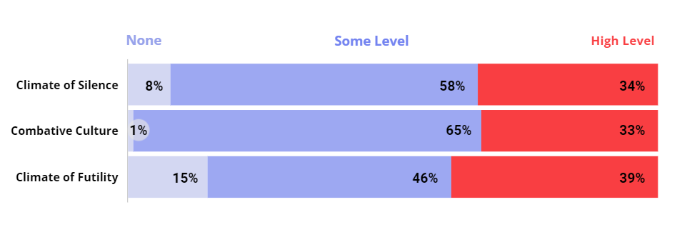
Negative Organizational Climates Are Powerful Barriers to Interrupting Sexism
Experiencing high levels of these three negative climates is common
Notes:
Climate of Silence: An environment where employees feel restrained from constructively speaking up about organizational or work-related problems, concerns, or challenges.
Combative Culture: A hyper-competitive workplace culture in which value is placed on four dimensions: show no weakness, display strength and stamina, put work first, and act as if it’s a dog-eat-dog world.
Climate of Futility: The sense that efforts to make change are not welcome and will not have the desired
19

Slide 20
How Organizations Can Encourage Men to Interrupt Sexism (Report), 2022
NOT ALL MEN INTERVENE WHEN THEY SEE OR HEAR SEXIST COMMENTS IN THE WORKPLACE
Actions organizations can take to engage men in combating workplace sexism:
Address systemic issues that perpetuate a climate of silence, a combative culture, and a climate of futility in the workplace.
Challenge rigid standards of masculinity and address systemic issues that increase masculine anxiety among men in the workplace.
Create an environment where managers are open and employees feel heard.
Notes:
WORKPLACES THAT WORK FOR WOMEN, 60 YEARS CATALYST
https://www.catalyst.org/research/workplace-sexism-climates/
As sexism against women in the workplace persists globally, many men want to be part of the solution. They have several advantages: Men hold most positions of power in organizations; they face fewer costs than women do when challenging other men for being sexist; and their responses to sexist comments are more likely to be considered than if they came from a woman.
However, we know that not all men intervene when they see or hear sexist comments in the workplace—and that in many situations, even men committed to combatting sexism against women may do nothing in response to a sexist act.
What can organizations do to help men become better partners in the struggle against workplace sexism?
Interrupting Sexism at Work, Catalyst’s global research series on the organizational conditions that encourage or discourage men from responding when they witness incidences of sexism at work, sought to answer this question.
Through studies in 12 countries across three global regions, we found three major actions organizations can take to engage more men in combatting workplace sexism:
Address systemic issues that perpetuate a climate of silence, a combative culture, and a climate of futility in the workplace. Data show that a large portion of men’s intent to do nothing in response to a sexist comment can be attributed to these three negative organizational conditions.
Challenge rigid standards of masculinity and address systemic issues that increase masculine anxiety among men in the workplace. Data show a direct link between masculine anxiety and men’s intent to do nothing. Masculine anxiety also boosts the link between a combative culture and doing nothing.
Create an environment where managers are open and employees feel heard. Data show a link between manager openness and men’s intent to directly interrupt sexism. Manager openness can also improve employee feelings of being heard, which is also linked to men’s intent to directly interrupt sexism.
20

Slide 21
POWER DYNAMICS AND POLITICS
Politics is the practice of actively navigating the human system. Organizations are human systems. Power in an organization is the flow of influence and priority in the organization. Power comes from energy.
Common sources of power are authority, economics, or personality.
Power can be hidden and informal, it doesn’t always follow the organizational hierarchy. An example of this is the administrative assistant, who shapes what an executive hears and sees.
Transformational leadership is a political role at the orgnization.
Leaders – agents of change.
Notes:
Formal power comes from the official position one holds within an organization or social structure. It is properly recognized by some type of written contract or official agreement, and regulated by a strict set of rules that everyone in the organization or social structure knows and must obey.
Formal forms of power exist in politics, business, religion, but also in social structures like a sports team or a student’s club. The manager of a company has formal power. So does the captain of a football team. This type of power changes as one’s official position within a structure changes, which is why many people compulsively seek to better their position.

Slide 22
Formal and Informal Power:
Formal power comes from the official position one holds within an organization or social structure.
Informal power comes, not from an official position, but from the respect and appreciation one has earned from the members of a group. This respect and appreciation allow the individual to influence his or her peers in a way that others within the group cannot.
informal power - by being known as very competent and skilled in what he does
informal power - by being likable and charismatic.
Notes:
Formal power comes from the official position one holds within an organization or social structure. It is properly recognized by some type of written contract or official agreement, and regulated by a strict set of rules that everyone in the organization or social structure knows and must obey.
Formal forms of power exist in politics, business, religion, but also in social structures like a sports team or a student’s club. The manager of a company has formal power. So does the captain of a football team. This type of power changes as one’s official position within a structure changes, which is why many people compulsively seek to better their position.

Slide 23
Practical examples
Make a group of 3-4 people. Discuss the statements, one in each group, about how your organizations are doing and what could be done about it.
What is the role of the formal and informal leaders of the organization here?
(10 min.)
Address systemic issues that perpetuate a climate of silence, a combative culture, and a climate of futility in the workplace.
Challenge rigid standards of masculinity and address systemic issues that increase masculine anxiety among men in the workplace.
Create an environment where managers are open, and employees feel heard.

Slide 24
References :
Sowon Kim, Giuliano Bianchi, Maria José Bosch (2020). An Examination of the Impact of Macro Context on Women CEOs in the Hospitality Industry. // in The New Ideal Worker (pp.251-265). https://www.researchgate.net/publication/334113553_An_Examination_of_the_Impact_of_Macro_Context_on_Women_CEOs_in_the_Hospitality_Industry
Hinchliffe, E. (2021). The number of women running Global 500 businesses soars to an all-time high. Fortune.
Gender matters: Rethinking violence in tourism. Annals of Tourism Research, J o u r n a l h o m e p a g e : h t t p s : / / w w w . j o u r n a l s . e l s e v i e r . c o m / a n n a l s - o f -t o u r i s m - r e s e a r c h https://www.sciencedirect.com/science/article/pii/S0160738321000050#bbb0075
Harvard Business Review, Power and Politics in Organizational Life (https://hbr.org/1970/05/power-and-politics-in-organizational-life)
Annals of Tourism Research, Volume 88, May 2021, Gender matters: Rethinking violence in tourism (https://www.sciencedirect.com/science/article/pii/S0160738321000050)
WORKPLACES THAT WORK FOR WOMEN, 60 years Catalyst (https://www.catalyst.org/research/workplace-sexism-climates/)
Protecting migrant workers from exploitation in the EU: workers’ perspectives
(https://fra.europa.eu/sites/default/files/fra_uploads/fra-2019-severe-labour-exploitation-workers-perspectives_en.pdf)
Same job, different income: withdrawing EU migrants’ benefits would violate an EU founding principle
(https://blogs.lse.ac.uk/brexit/2015/11/17/in-work-benefits-for-migrants-digging-a-hole/)

Slide 25
References :
TOURISM’S DIRTY SECRET: THE EXPLOITATION OF HOTEL HOUSEKEEPERS: oxfam canada report. (https://oxfamilibrary.openrepository.com/bitstream/handle/10546/620355/rr-tourisms-dirty-secret- 171017-en.pdf%3Bjsessionid=793604C2A572759E16008BC94B70C503?sequence=1)
https://www.catalyst.org/research/women-in-management/

Slide 26
Thank you for your attention

Slide 27
Project partners
DEKAPLUS
Cyprus
Czech University of Life Sciences Prague Czech Republic
DIAS Greece
OUT LOUD
Latvia
Social Innovation Fund Lithuania
Pancyprian Association of Hotel Managers Cyprus
Beneke & Prinzhorn GmbH Germany
https://www.weedout.eu/

