Slide 1
Effects of exposure to workplace violence
The European Commission's support for the production of this publication does not constitute an endorsement of the contents, which reflect the views only of the authors, and the Commission cannot be held responsible for any use which may be made of the information contained therein.

Slide 2
Topics
1. Potential consequences for affected persons (psychological and physical consequences, consequences at the workplace, ....)
2. Potential consequences for the company (economic consequences, consequences in cooperation, consequences for employees involved, consequences in external effects, structural consequences,...)
3. Power of the bystander approach

Slide 3
Learning Outcomes
He/she is able to understand the effects of occupational violence at different levels (individual, interpersonal, institutional, etc.).
He/ she is able to develop effective measures to constructively counteract these effects.
He/ she is able to cope with a possible bystander approach on a professional level.
https://www.weedout.eu/

Slide 4
1. Potential consequences for affected persons

Slide 5
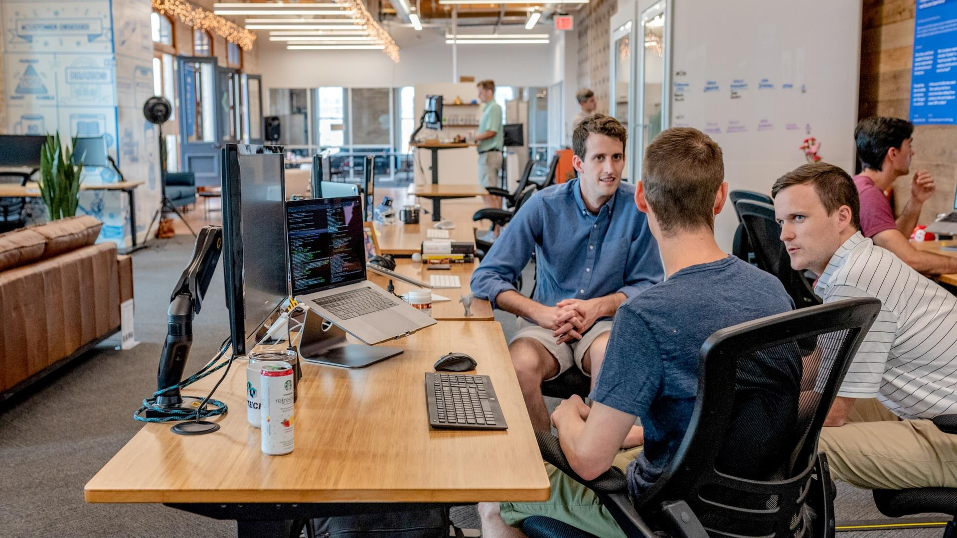
Group Activity
- What are the possible consequences when a person experiences any type of violence in the workplace? Either physical or verbal.
Write down your answers and in groups of 4 share and discuss your answers. (20 min.)
Each group should present a real-life example/case. (15 min.)

Slide 6
Potential consequences for affected persons
Physical injuries, post-traumatic stress disorder, depression, anxiety, fear, and even suicide.
A drastic change in the individual’s job motivation and satisfaction. Serious injuries that may lead to serious disabilities that require ongoing care or are life-threatening and even death.

Slide 7
Psychological Consequences of WPV
Emotional violence can result to:
Fear
Guilt
Anxiety
Self-blame
Anger
Shame
Insecurity
Burnout
Depression
Post-traumatic stress
Emotional exhaustion
Suicidal thoughts

Slide 8
Physical Consequences of WPV
Physical Violence may result to:
Panic Attacks
Physical Injuries
Sleep Disruption/Insomnia
Numbness
Loss of concentration/memory
Homicides
Headaches/Migraines
Uncontrollable mood swings
Muscle Tension
Fibromyalgia (musculoskeletal pain accompanied by fatigue etc.
Changes in appetite
Uncontrollable crying
Nausea
High blood pressure
Chest Pain
https://www.weedout.eu/

Slide 9
2. Potential consequences for the company

Slide 10
2. Potential consequences for the company
The effect that workplace violence can have on an organisation can be incredibly damaging to the company in a direct and indirect way.
The direct effect on the organisation would be the financial payment to the affected person (victim) who might have been physically injured for compensation or any medical expenditure needed.
The indirect effect on the organisation would be the external factors that can have an influence on the organisation such as shareholders, reputation and image, investors and more.

Slide 11
Direct cost on organisation includes:
Low worker morale
Increased accidents
Absenteeism
Decreased performance and productivity
Sick leave, property damage
Security costs
Early retirement
Worker's compensation
High turnover
Reduced trust of management
Grievances and litigation
Loss of public prestige

Slide 12
Indirect Cost of Organisation includes:
Negative reaction and attention by external parties
Legal actions against the company
Loss of public trust and others
Lack of personnel / Low interest in company
Negative reputation
Negative image
Loss of business relationships
Decrease of profit

Slide 13
Group Activity (30 min.)
An
In groups of 4 think of a case where an organisation faced any direct or indirect costs due to an incident that occurred. Make a list of those costs by category and explain how the organisation was affected.
In your group discuss how you would face such an incident if you were in charge.

Slide 14
The Case of Uber: Reputational and Financial Damage as a direct and indirect cost for the company
- Uber was accused by over 56 employees of sexual harassment, discrimination and other resulting to:
A settlement of over 20 million in total
Huge loss of customers
High employee turnover including CEO removal and employees quitting
Costly implementation of new strategies, approaches and trainings

Slide 15
3. The power of the bystander approach

Slide 16
3. The power of the bystander approach
An approach towards sexual violence prevention. It is the act of stepping in when witnessing violent incidents and/or recognising and reporting such acts.
1. It encourages the community to take ownership of sexual violence as a problem and speak up when they witness potentially dangerous situations or sexist language
2. Reduces victim blaming, includes everyone (gets men involved in a community issue, not a women's issue)
3. Gives the community an opportunity to foster social change.
https://www.weedout.eu/

Slide 17
How to be an Active Bystander:
Act on any inappropriate or threatening behaviour. If you feel uncomfortable doing it directly then get help from an authority or a trusted person around you.
The bystander intervention can be an effective way of stopping sexual assault before it happens. It plays a key role in preventing, discouraging, and/or intervening when an act of violence has the potential to occur.

Slide 18
The ABC approach
Recommended Strategies to successfully implement the Bystander Approach
The ABC approach should be practised before taking the decision to step in an incident that is occurring - This is an approach that mainly applies to employees.
If you see someone in trouble, ask yourself if you can help safely in any way. It is important to remember that your personal safety is a priority - never put yourself at risk.
Assess for safety
It’s safer to call out behaviour or intervene while in a group. If this is not an option, report it to others who can act.
Be in a group
Talk to the person whom you think may need help and ask them if they are OK.
Care for the victim

Slide 19
How to intervene safely with the 4 Ds strategy When it comes to intervening safely, remember the four Ds – direct, distract, delegate, delay.
Direct action Call out negative behaviour once detected, tell the person to stop and/or ask the victim if they are OK. Do this as a group if you can and be polite. Don’t aggravate the situation - remain calm and state why something has offended you. Stick to exactly what has happened and don’t exaggerate.
Distract Interrupt, start a conversation with the perpetrator to allow their potential target to move away or have others intervene. You can come up with an idea to get the victim out of the situation such as telling them they need to take a call, or you need to speak to them; any excuse to get them away to safety. Alternatively, try distracting, or redirecting the situation.

Slide 20
Delegate If you are too embarrassed or shy to speak out, or you don’t feel safe to do so, get someone else to step in.
Delay
If the situation is too dangerous to intervene (such as there is the threat of violence or you are outnumbered) then just walk away and wait for the situation to pass. Ask the victim later if they are OK or report it when it’s safe to do so

Slide 21
Group Activity (30 min.)
For 30 minutes play the Weed Out Card Game (Instructions to be provided in class)
Notes:
Play Weed Out Card Game (provide instructions) - Methodology Recognize and act How to play.pptx - Google Slides

Slide 22
References & Further links
A Bystander Intervention Training - https://righttobe.org/guides/bystander-intervention-training/
A guide to the Bystander Approach and further reading - https://drexel.edu/~/media/Files/oed/PDF/soc_bystander_intervention_guide_web_final.ashx;_z=z?la=en
American Academy of Experts in Traumatic Stress 2020 - https://www.aaets.org/traumatic-stress-library/workplace-violence
Andoh, A. K. (2001) sexual harassment in the workplace: The Ghanaian experience, Centre for Social Policy Studies (CSPS), University of Ghana, Legon, No. 9 ISSN 0855-3726
Bureau of Labour Statistics (2012). Census of Fatal Occupational Injuries Summary. Retrieved on April 3, 2014 from http://www.bls.gov/iif/ osh_wpvs.htm
Bystander Approaches - https://aifs.gov.au/sites/default/files/publication-documents/acssa-issues17_1.pdf
https://core.ac.uk/download/pdf/234669966.pdf
https://www.weedout.eu/

Slide 23
https://core.ac.uk/download/pdf/234669966.pdf
https://www.breakingthesilence.cam.ac.uk/prevention-support/be-active-bystander
https://www.medicaldaily.com/physical-effects-workplace-aggression-toll-bullying-takes-your-mind-and-body-247018
https://www.ncbi.nlm.nih.gov/pmc/articles/PMC7215457/#:~:text=WPV%20may%20cause%20not%20only,shame%20%5B2%2C8%5D
https://www.ncbi.nlm.nih.gov/pmc/articles/PMC7215457/#:~:text=WPV%20may%20cause%20not%20only,shame%20%5B2%2C8%5D
https://www.researchgate.net/publication/313425432_The_Bystander_Approach_to_Sexual_Assault_Risk_Reduction_Effects_on_Risk_Recognition_Perceived_Self-Efficacy_and_Protective_Behavior
Marit Vartia-Väänänen, M. (2009). Organisational and individual consequences of workplace violence and harassment. Retrieved on March 7, 2014 from https://osha.europa.eu/en/seminars/seminar-on- violenceand-harassment-at-work/speech- venues/day-1/spspeech.2010-12-14.2867785670

Slide 24
Project partners
DEKAPLUS
Cyprus
Czech University of Life Sciences Prague Czech Republic
DIAS Greece
OUT LOUD
Latvia
Social Innovation Fund Lithuania
Pancyprian Association of Hotel Managers Cyprus
Beneke & Prinzhorn GmbH Germany
https://www.weedout.eu/

